Slide 1
Object oriented programming
Lecture #1: Introduction
by
Mrs. Akhila Pragada

Slide 2
Java is _____
simple programming language
one of the most popular programming language
open-source and free
has a huge community support (tens of millions of developers)
close to C & C++
it helps to create modular programs and reusable code
write a program once and then run this program on multiple operating systems
works on different platforms (Windows, Mac, Linux, Raspberry Pi, etc.)
Java is a high-level, object-oriented programming language

Slide 3
Java is used
Mobile applications (specially Android apps)
Desktop applications
Web applications
Gaming Applications
Cloud-based Applications
Software Tools
Database connection
And much, much more!

Slide 4







Companies that use java

Slide 5

Java history
Developed by Sun Microsystems Inc in 1991
Initially named as Oak, later changed to Java
First publicly available version – Java 1.0 released in 1995
Oracle corporation acquired Sun Microsystems in 2010
The latest version of Java is Java 14 or JDK 14 released on March, 17th 2020

Slide 6
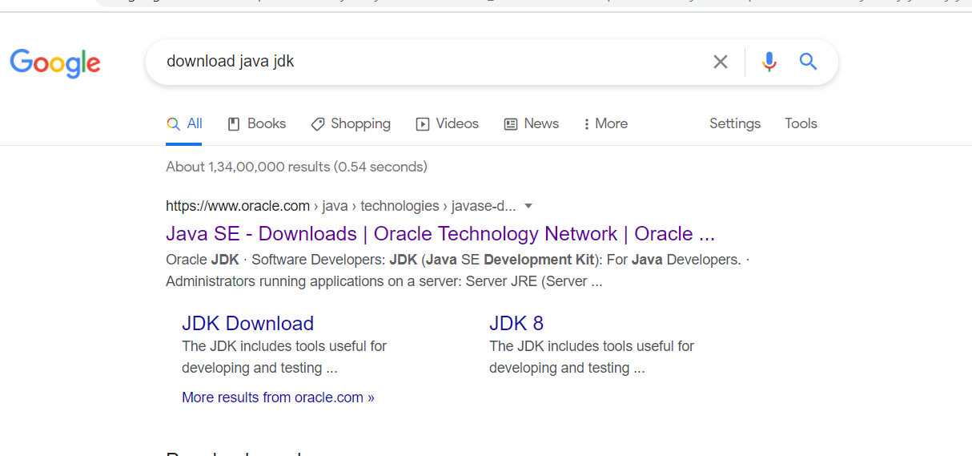
Installation

Slide 7
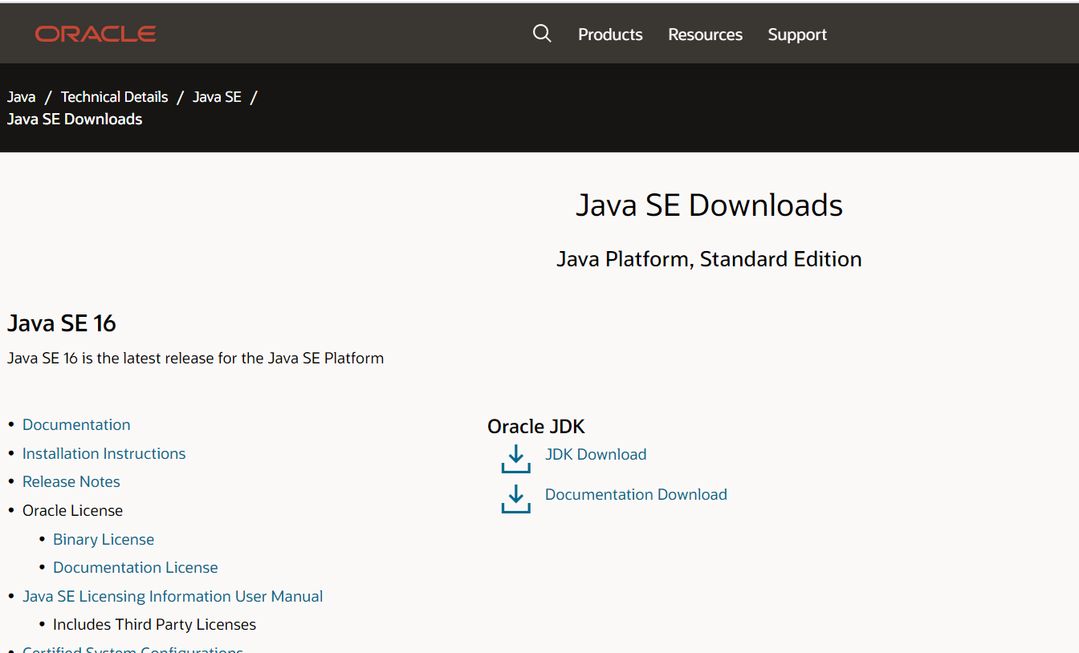
Installation

Slide 8
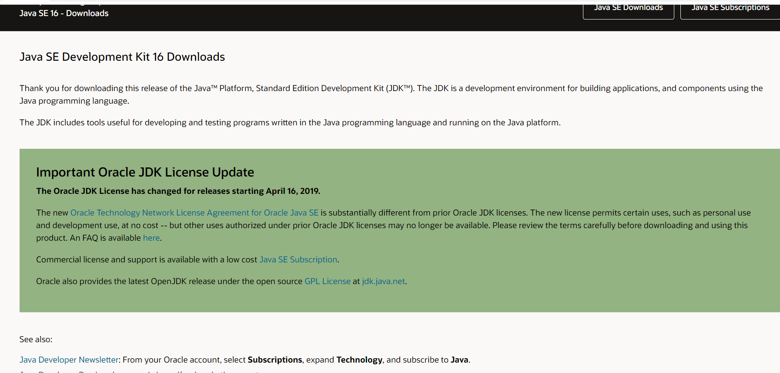

Slide 9
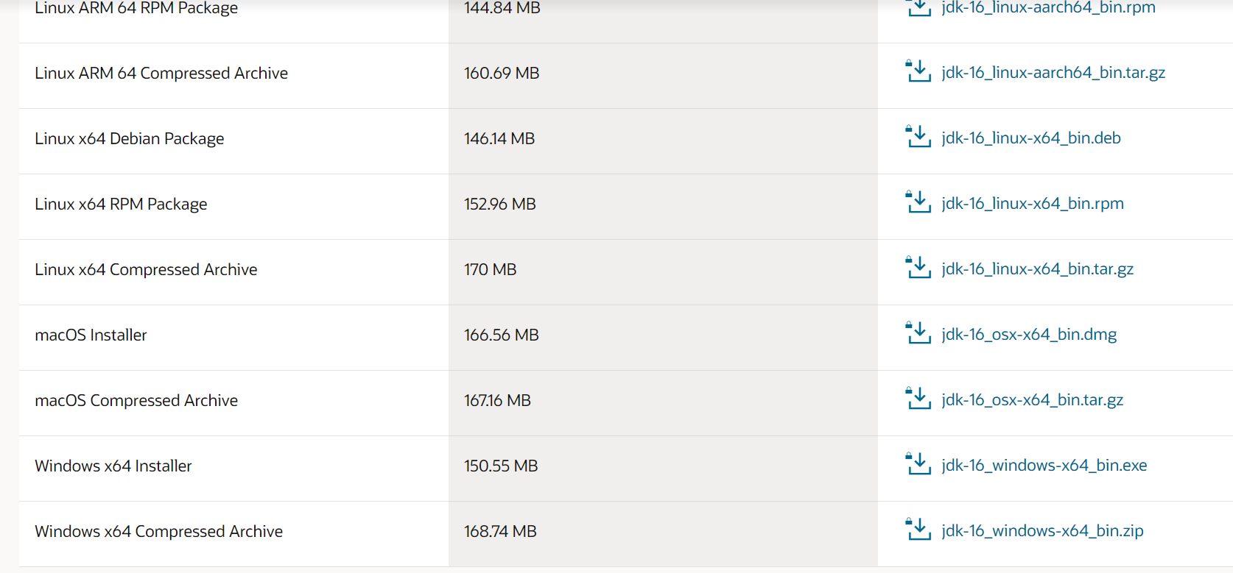
installation

Slide 10
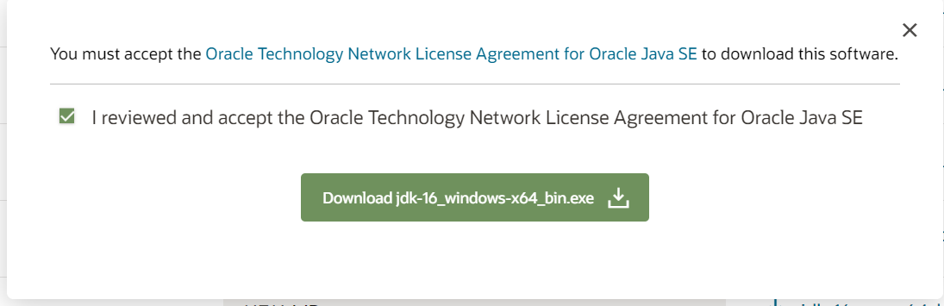
installation

Slide 11
Object oriented programming
Lecture #2: POP vs OOP
by
Mrs. Akhila Pragada

Slide 12
Programming Languages
Programming languages
Procedure Oriented languages
Object Oriented languages

Slide 13
Procedure oriented programming (POP)
Large Programs are divided into sequence of functions (Procedures)
Each procedure can be called by another procedure during execution by calling it using its name
In POP main focus is on procedures only not on data
Follows “Top-Down Approach”.
Program
Function 1
Function 2
Function 3

Slide 14
Procedure oriented programming (POP)
Global variables can be accessed by all functions
No security to data - Data can be freely moved from one procedure to another procedure
If we need to change the type of data of global variable then we need to revise all the functions that are using this global variables. Failing this may result in errors
POP does not model real world problems very well. Because functions are action oriented
Examples: C, PASCAL, COBOL, BASIC, FORTRAN
Global Variables 1
Global Variables 2
Function 1
Local variables
Function 2
Local variables
Function 3
Local variables

Slide 15
Object oriented programming (oOP)
In OOP data is secured -does not allow it to flow freely among functions
Program is divided into objects and then built functions and data around these objects.
Student Object
Object 1
Object 2
Name
Rollno
Age
Branch
Data
Data
Functions
Functions
Attendance
Percentage
Data
Object 3
Functions

Slide 16
Object oriented programming (oOP)
Data of an object is accessed only by the functions associated by that object
Objects communicate with each other through functions
In OOP emphasis is given to data rather than procedures
OOP follows “Bottom-Up Approach”
Examples: Java, VB.Net, C#
Main Program
Function 1
Function 2
Function 3

Slide 17
POP vs OOP
Procedure Oriented Programming
Object Oriented Programming
Program is divided into smaller programs called Procedures
Top-Down Approach
Importance is given to procedures rather than data
No security to data
Does not model real-world problems very well
Suitable for developing medium size projects
Program is divided into entities called Objects
Bottom-Up Approach
Importance is given to data rather than Procedures/functions
Data is Secure
Model real-world problems
Suitable to developing large size projects

Slide 18
C vs java
C
Java
Procedure Oriented Programming Language
Complied
Supports Preprocessor Directives
User takes care of memory management
Uses pointers
Platform dependent
Variable declaration at the beginning of the block
Uses global variable
Object Oriented Programming Language
Complied & Interpreted
Does not support preprocessor directives
Internally manages the memory
Does not use pointers
Platform independent
Variable can be declared anywhere
No global variable

Slide 19
Object oriented programming
Lecture #3: Features of Java

Slide 20
Characteristics of OOP
Object
Class
Data Abstraction
Encapsulation
Inheritance
Polymorphism
Dynamic Binding
Message Passing

Slide 21
Class & Object
A class is a data type that allows programmers to create objects. A class provides a definition for an object, describing an object’s attributes (data) and methods (operations).
An object is an instance of a class. With one class, you can have as many objects as required.
This is analogous to a variable and a data type, the class is the data type and the object is the variable.

Slide 22
Data abstraction
Data abstraction is the process of hiding certain details and showing only essential information to the user.

Slide 23
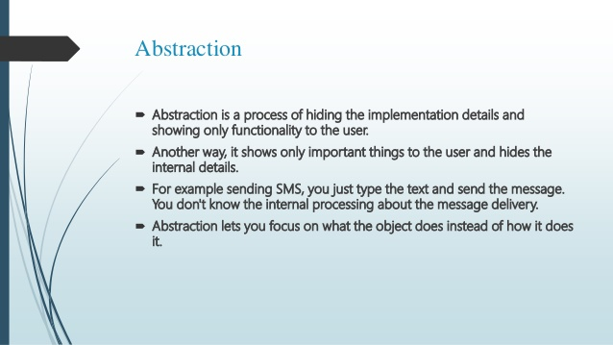
abstraction

Slide 24
Encapsulation
Encapsulation is a mechanism of wrapping the data (variables) and code acting on the data (methods) together as a single unit.

Slide 25
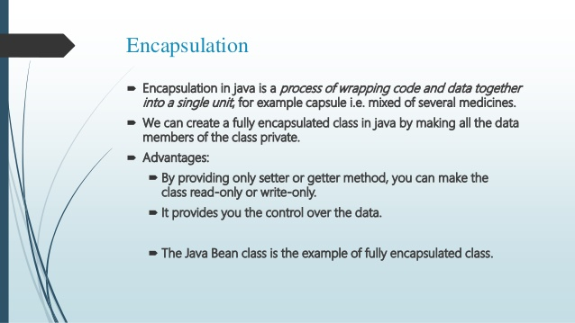
encapsulation

Slide 26
Inheritance
Inheritance can be defined as the process where one class acquires the properties (methods and fields) of another class.

Slide 27
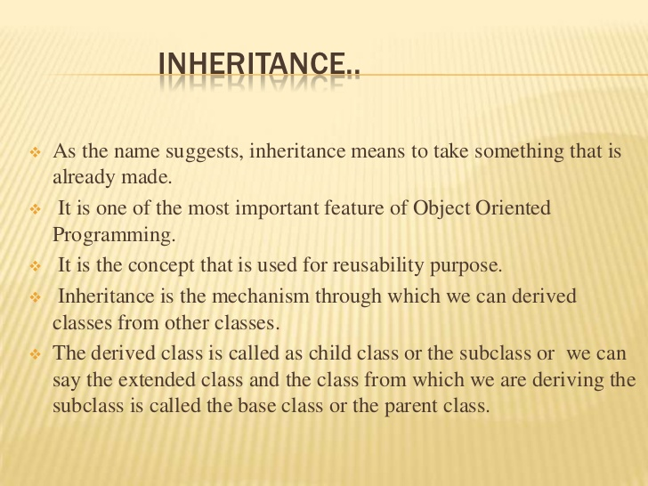

Slide 28
Polymorphism
An operation exhibits different behaviors in different instances

Slide 29
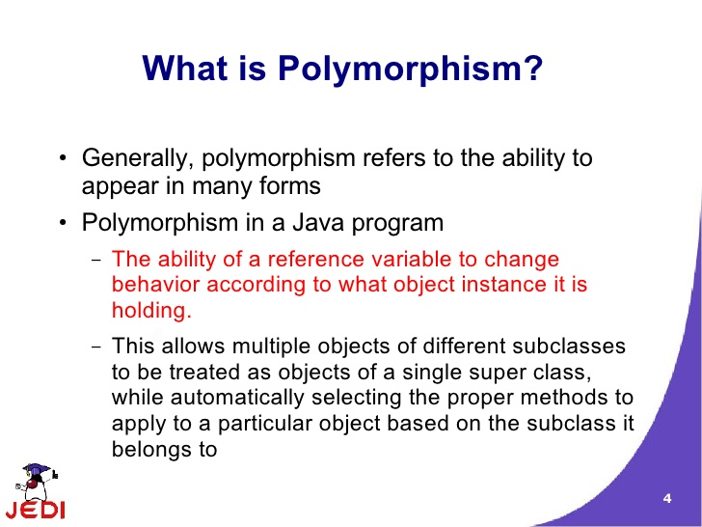

Slide 30
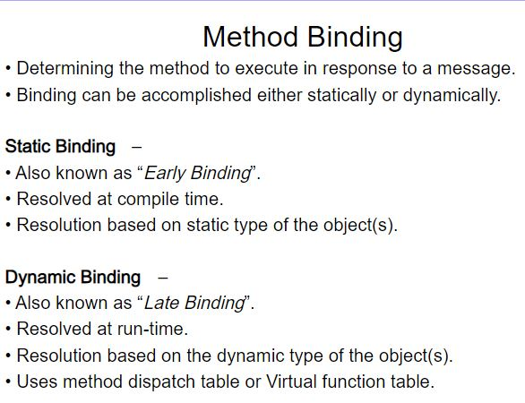

Slide 31
Dynamic Binding
Dynamic binding also called dynamic dispatch is the process of linking procedure call to a specific sequence of code (method) at run-time.
It means that the code to be executed for a specific procedure call is not known until run-time.
Dynamic binding is also known as late binding or run-time binding.

Slide 32
Message Passing
Message Passing is nothing but sending and receiving of information by the objects same as people exchange information.

Slide 33
Features of java
Object
Class
Data Abstraction
Encapsulation
Inheritance
Polymorphism
Dynamic Binding
Message Passing
Platform independent
Compiled and interpreted
Robust and secure
Distributed
Multi-threading
Dynamic and extensible

Slide 34
JAVA BUZZWORDS
Platform independent
“Write once and run anywhere”
Secure
Based on public key encryption and helps to design virus free systems
Architectural and Neutral
Ability of generating Architectural-neutral objects that can run on multiple processors
Portable
Uses a compiler that is written using ANSI C and POSIX sub suit making it portable
Robust
Eliminates the most number of errors in the compile time itself
Multi-Threading
Capable to execute code simultaneously above multiple processors at a time.

Slide 35
Object oriented programming
Lecture #4: First Java program

Slide 36
Java virtual machine (JVM)
Byte Code
Execute (JVM)
Java File
Compiler
Output
.class file

Slide 37
Simple java program
class classname
{
public static void main (String a[])
{
Block of statements
}
}
class First
{
public static void main (String a[])
{
System.out.print(“First java program”);
}
}
Note:
Java is case sensitive
class name first letter should be capital
Every statement should end with semicolon
keywords:
class, public, static, void

Slide 38
Compiling and executing
Byte Code
Execute (JVM)
Java File
Compiler
Output
.class file
Saving:
First.java
Compiling:
javac First.java
Execution:
java First
Settig class path

Slide 39
Object oriented programming
Lecture #5: Compiling & Executing Javaprogram (Setting classpath)

Slide 40
Simple java program
class First
{
public static void main (String a[])
{
System.out.print(“First java program”);
}
}
Note:
Java is case sensitive
class name first letter should be capital
Every statement should end with semicolon
keywords:
class, public, static, void

Slide 41
Compiling and executing
Byte Code
Execute (JVM)
Java File
Compiler
Output
.class file
Saving:
First.java
Compiling:
javac First.java
Execution:
java First
Setting class path

Slide 42
Object oriented programming
Lecture #6: Structure of Java Program

Slide 43
Structure of java program
Documentation Section
Package Statements
Import Statements
Optional
Interface Statements
Class Definitions
Main method class
{
main method
definition
}
Essential

Slide 44
Documentation section
Used for writing comment lines
Ignored by compiler
3 ways:
//
This is for single line Ex: //Welcome to Java program
/* */
This is for multiple lines Ex: /* Welcome to
Java Program */
/** */
This is used to generate automatic comment

Slide 45
Package statement
Java packages are a mechanism to group Java classes that are related to each other, into the same "group" (package)
Ex: package Employee

Slide 46
Import statements
To import java package into a class, we need to use java import keyword which is used to access package and its classes into the java program
Can import built-in and user-defined packages
Ex: import java.lang.Math.*;
Import java.util.*;

Slide 47
Interface statements
Used to achieve multiple inheritance

Slide 48
Class definitions
Any number of classes can be defined
All the objects of class should be created in main method.
One class should have main method—Main method class
Class Definitions
Optional
Main method class
{
main method
definition
}
Essential

Slide 49
Object oriented programming
Lecture #7: Variables & Datatypes

Slide 50
variable
A Java variable is a piece of memory that can contain a data value.
Variables are typically used to store information
Variable Declaration:
Variable Assignment:
Assigning a value to a variable
Syntax:
datatype variable name;
Example:
int a;
Syntax:
variable name=value;
Example:
a=10;

Slide 51
variable
Variable Naming Conventions:
Java variable names are case sensitive. The variable name apple is not the same as Apple or APPLE.
Java variable names must start with a letter, or the $ or _ character.
After the first character in a Java variable name, the name can also contain numbers (in addition to letters, the $, and the _ character).
Variable names cannot be equal to reserved key words in Java. For instance, the words int or for are reserved words in Java. Therefore you cannot name your variables int or fo

Slide 52
Datatypes in java
Data type specifies the size and type of values that can be stored in an variable.
Derived Datatype
DataType
Primitive
Non-Primitive
Numeric
Non-Numeric
classes
Array
Integer
Floating Point
Char
Boolean
Interface

Slide 53
integer
Integer types can hold whole numbers such as 123 and −96.
The size of the values that can be stored depends on the integer type that we choose.
1 byte = 8 bits
Type
Size
Range of values that can be stored
byte
1 byte
−128 to 127
−128 to 127
short
2 bytes
−32768 to 32767
−32768 to 32767
int
4 bytes
−2,147,483,648 to 2,147,483,647
Example:
inr a;
byte b;
a=10;
long
8 bytes
9,223,372,036,854,775,808 to 9,223,372,036,854,755,807
The range of values is calculated as −(2^{n−1}) to (2^{n−1})−1; where n is the number of bits required.

Slide 54
Floating Point
Floating point data types are used to represent numbers with a fractional part.
There are two subtypes:
Type
Size
Range of values that can be stored
float
4 byte
3.4e−038 to 3.4e+038
double
8 bytes
1.7e−308 to 1.7e+038
Example:
float a;
double b;
a=4.7;

Slide 55
Character
It stores character constants in the memory
It assumes a size of 2 bytes
Basically it can hold only a single character
Keyword: char
Keep the value in single quote.
Example:
char a;
char b;
a=‘k’;
b=‘2’;

Slide 56
Boolean
Boolean data types are used to store values with two states: true or false.
Its size is 1 bit
Keyword: boolean
Example:
boolean a;

Slide 57
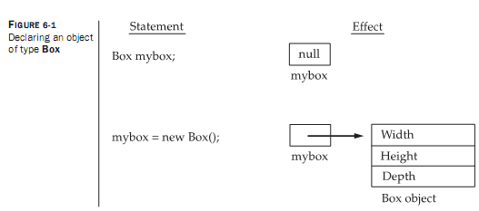
Object declaration

Slide 58
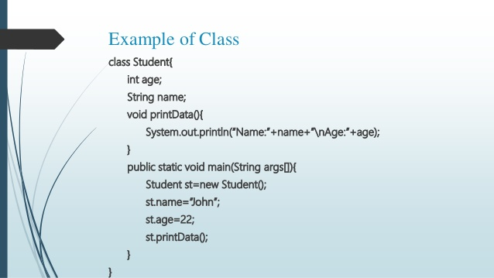
Example program

Slide 59
Basic Program Development
Edit and
save program
errors
errors
Compile program
Execute program and
evaluate results

Slide 60
Java Environment/
Life Cycle of Java Code
Compile-time Environment
Runtime Environment
Class Loader
Bytecode
Verifier
Java Class
Libraries
Java
Source
(.java)
Java
Interpreter
Just in Time
Compiler
Java
Bytecodes
move locally
or through
network
Java
Virtual
machine
Java
Compiler
Runtime System
Java
Bytecode
(.class )
Operating System
Hardware

Slide 61
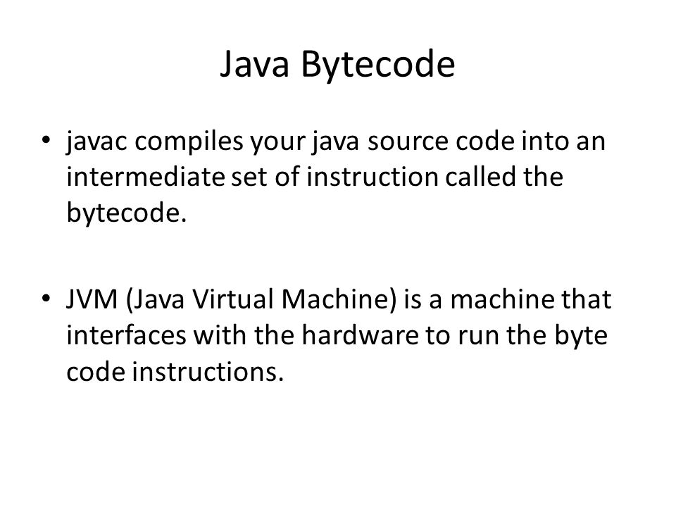
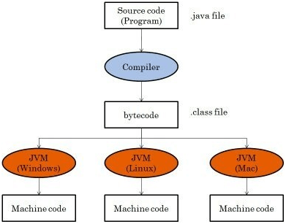

Slide 62
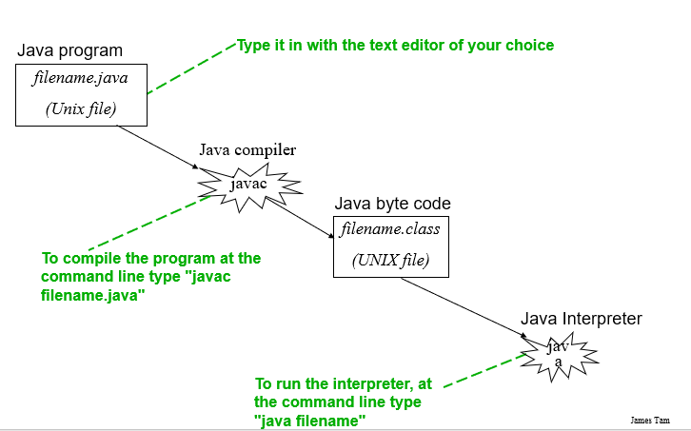
Creating, compiling and running java programs

Slide 63
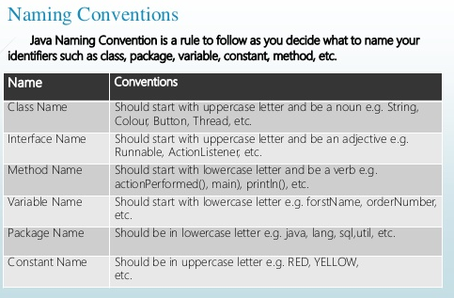

Slide 64
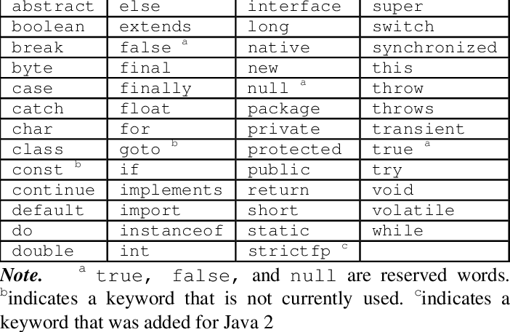
Java keywords

Slide 65
Operator evaluation
Parentheses have the highest precedence and it can be used to force an expression to evaluate in order you want.
(3-1) is 2 and(1+1) **(5-2) is 8. you can also use parentheses to make an expression easier to read, as in (min*100)/60, even though it does not change the result.
Exponentiation has the next highest precedence, so 2**1+1 is 3 and not 4 and 3*1**3 is 3 and not 27.
Multiplication and division have the same precedence which is higher than addition and subtraction which also has the same precedence. So 2*3-1=5 and 2/3-1=-1(integer division, 2/3=0).
Operators with the same precedence are evaluated from left to right. So in the expression min*100/60, the multiplication operation takes first place, yielding 5900/60 which in turn yields 98.
If the operations had been evaluated from right to left, the result would have been 59*1 that produce the result as 59 which is wrong

Slide 66
Example:
12+20*2-4*2/2.0 # 48.0
1. 12+40-4*2/2.0
2. 12+40-8/2.0
3. 12+40-4.0
4. 52-4.0
5. 48.0
12+(20*2)-4*(2/2.0) # 48.0
12+(20*2)-(4*2)/2.0 # 48.0
expression is evaluated from left -> right. BODMAS(bracket of division multiplication) rule is followed while evaluating the expression.

Slide 67
Object oriented programming
Lecture #8: Control Statements in Java
(Part-1)

Slide 68
Control Statements
Control Statements
Selection Statements
Transfer Statements
Iterative Statements

Slide 69
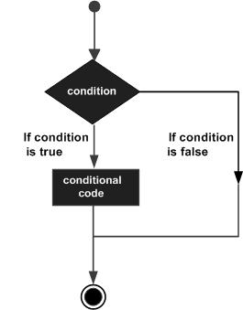
selection Statements (if)
“Simple if”
Syntax:
if(condition)
{
block1- stmt1
block1-stmt2
}
Flow Chart
Example
//checking the age
if(age>18)
System.out.print("Age > 18");

Slide 70
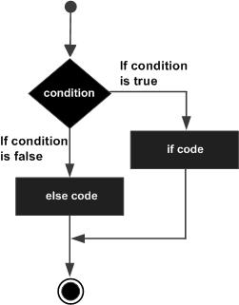
selection Statements (if)
“if-else Statement”
Syntax:
if(condition)
{
block1-stmt1
block1-stmt2
}
else
{
block2-stmt1
block2-stm2
}
Flow Chart
Example
if( x < 20 )
{
System.out.print(“Yes");
}
else
{
System.out.print(“NO”);
}

Slide 71
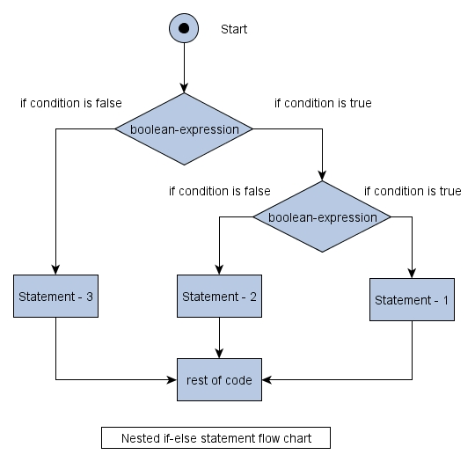
selection Statements (if)
“Nested if-else Statement”
Syntax:
if(condition)
{
if(condition)
{
block1-stmt1
block1-stmt2
}
else
{
block2-stmt1
block2-stm2
}
}
else
{
block3-stmt1
block3-stm2
}
}
Flow Chart
Example
if( a>b)
{
if(a >c)
System.out.print(“A is big");
else
System.out.print(“b is big");
}
else
{
if(b >c)
System.out.print(“B is big");
else
System.out.print(“b is big");
}

Slide 72
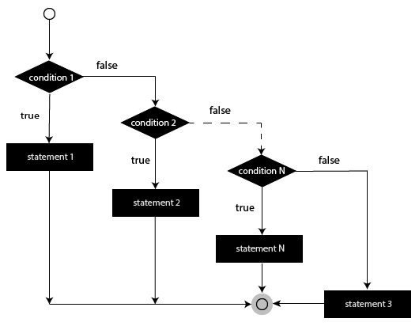
selection Statements (if)
“else-if Ladder Statement”
Syntax:
if(condition)
{
block1-stmt1
block1-stmt2
}
else
{
if(condition)
{
block2-stmt1
block2-stmt2
}
else
{
block3-stmt1
block3-stm2
}
}
Flow Chart

Slide 73
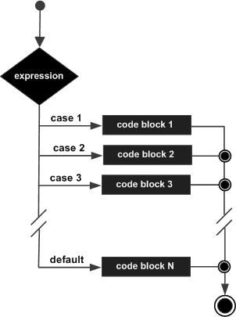
selection Statements (switch)
“switch Statement”
Syntax:
switch(expression)
{
case value :
// Statements
break; // optional case value :
// Statements
break; // optional
// You can have any number of case statements.
default : // Optional
// Statements
}
Flow Chart
Example
switch(grade)
{
case 'A' :
System.out.println("Excellent!");
break;
case 'B' :
case 'C' :
System.out.println("Well done");
break;
case 'D' :
System.out.println(“Passed");
break;
case 'F' :
System.out.println(“Fail");
break;
default :
System.out.println("Invalid grade"); }

Slide 74
Object oriented programming
Lecture #9: Control Statements in Java
(Part-2)
by

Slide 75
Control Statements
Control Statements
Selection Statements
Transfer Statements
Iterative Statements

Slide 76
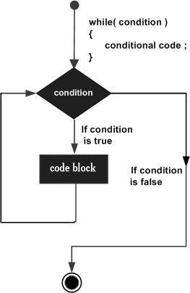
Iterative Statements (while)
“while”
Repeatedly executes the block of statements as long as the condition is true
Entry-controlled Loop
FlowChart
Syntax:
while(expression)
{
block1- stmt1
block1-stmt2
}
Example:
x=0
while( x<10)
{
System.out.println(x);
x=x+1;
}
print(“End of while”)

Slide 77
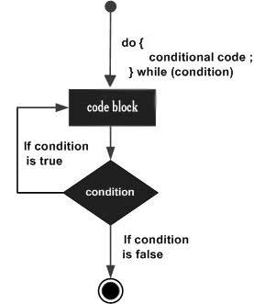
Iterative Statements (do-while)
“do-while”
Repeatedly executes the block of statements until the condition becomes False
Exit-controlled Loop
FlowChart
Syntax:
do
{
block1- stmt1
block1-stmt2
} while(expression);
Example:
x=0
do
{
System.out.println(x);
x=x+1;
}
while( x<10);
print(“End of do-while”)

Slide 78
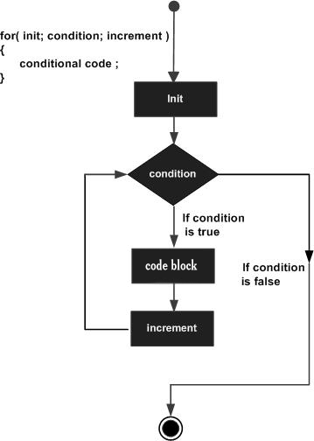
Iterative Statements (for)
“for”
Flowchart
Syntax:
for(initialization; Boolean_expression; update)
{
// Statements
}
Example:
for(int x = 10; x < 20; x = x + 1)
{
System.out.print("value of x : " + x );
}

Slide 79
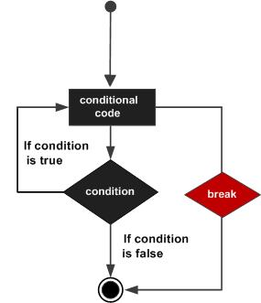
Transfer Statements (break)
“break”
When the break statement is encountered inside a loop, the loop is immediately terminated and the program control resumes at the next statement following the loop.
Flowchart
Syntax:
break;
Example:
for(int i = 1; i < 5; i ++)
{
if( i == 3 )
break;
System.out.println( i );
}
Output:
1
2

Slide 80
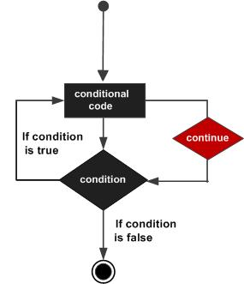
Transfer Statements (continue)
“continue”
In a loop, the continue keyword causes control to immediately jump to the next iteration.
Flowchart
Syntax:
continue;
Example:
for(int i = 1; i < 5; i ++)
{
if( i == 3 )
continue;
System.out.println( i );
}
Output:
1
2
4

Slide 81
Object oriented programming
Lecture #10: Class & Object

Slide 82
Class definitions
Any number of classes can be defined
One class should have main method—Main method class
All the objects of class should be created in main method.
Class Definitions
Optional
Main method class
{
main method
definition
}
Essential

Slide 83
class
Defining a class:
A class can be defined as a template/blueprint that describes the behavior/state that the object of its type support.
Optional
Syntax:
[Access_Modifier] class class_name
{
Fileds declaration;
Methods declerations;
}
Variables
Members
Functions

Slide 84
class
class_name:
Field declaration:
Example:
class Student
class Example
Instance variables are created at the time of object creation
Syntax:
[Access Modifier] type Variable_name;
[initial value]
Optional
Example:
int age;
float marks;
float studentHeight;
Instance Variable

Slide 85
class
Method declaration:
Syntax:
[Access Modifier] returntype identifier (Paramenter_list)
{
method_body
}
Optional
Example:
int add( int x, float b)
{
statements
}
Example:
int getStudentData( int x, float b)
{
statements
}

Slide 86
Class- Example
Example:
class Student
{
int a,b;
int add( int x, float b)
{
statements
}
}

Slide 87
object
An object is an instance of a class.
To create an object “new” operator is used
Object creation:
2 parts-
Declare the object
Instantiate the object
Example:
class Student
{
int a,b;
int add( int x, float b)
{
statements
}
}
Object creation:
Student obj;
obj=new Student();
Object creation:
Student obj=new Student();

Slide 88
Object
Class creation:
class Student
{
int a,b;
int add( int x, float b)
{
statements
}
}
Accessing class members
using .(dot) Operator
Syntax:
objectname.variable_name=value;
objectname.methodname(parameter_list);
Example:
obj.a=10;
obj.add(25,33.5);
Object creation:
Student obj=new Student();

Slide 89
object
Multiple objects can be created from a single class
Class creation:
class Student
{
int rollno;
int add( int x, float b)
{
statements
}
}
Object creation:
Student s1=new Student();
Student s2=new Student();
Student s3=new Student();
s1.rollno=12;
s2.rollno=23;
s3.rollno=45;

Slide 90
Program with multiple classes
class Example
{
int a,b,c;
void getData(int x, int y)
{
a=x;
b=y;
}
void add( )
{
c=a+b;
System.out.print(“Sum is :”+c);
}
}
class Addition
{
public static void main(String args[])
{
Example obj1=new Example();
obj1.getData(25,25);
obj1.add();
}
}
Output:
Sum is :50

Slide 91
Program with multiple classes
class Example
{
int a,b,c;
void getData(int x, int y)
{
a=x;
b=y;
}
void add( )
{
c=a+b;
System.out.println(“Sum is :”+c);
}
}
class Addition
{
public static void main(String args[])
{
Example obj1=new Example();
obj1.getData(25,25);
obj1.add();
Example obj2=new Example();
obj2.getData(5,2);
obj2.add();
}
}
Output:
Sum is :50
Sum is :7

Slide 92
Object oriented programming
Lecture #11: Array in Java-Introduction

Slide 93
Why Array?
Array is used to hold more than one value with same variable name
Consider :
int a;
a=10;
a=20;
System.out.print(“a= “+a);
Consider :
int a;
a=10;
System.out.print(“a= “+a);
b=20;
System.out.print(“b= “+b);
Output:
a= 20
Output:
a= 10
b=20
A Variable will hold only one value at a time

Slide 94
Array
Java array is an object which contains elements of a similar data type.
The elements of an array are stored in a contiguous memory location.
3 Steps:
Declaration of array
Instantiate the array
Initialization of array

Slide 95
Array
Declaration of Array:
Specifying Array name and datatype
2 forms
Syntax(Form-1):
type array_name[ ];
Syntax(Form-2):
type[ ] array_name;
Example(Form-1):
int roll_no[ ];
Example(Form-2):
int[ ] roll_no;
Don’t Mention the size

Slide 96
Array
Instantiate the Array:
Allocating the memory to the array
uses “new” operator
Combining Declaration & Instantiate the Array:
Example:
int roll_no[ ];
Syntax:
array_name= new type[ size];
Example:
roll_no=new int[5 ];
Syntax:
type array_name[ ]= new type[ size];
Example:
int roll_no[ ]=new int[5 ];

Slide 97
Array
Memory Allocation:
roll_no
int roll_no[ ];
.
Points Nothing
roll_no
.
roll_no=new int[5 ];
roll_no[ 0]
roll_no[ 1]
Array in Java is index-based,
the first element of the array is
stored at the 0th index,
2nd element is stored on 1st index
and so on.
roll_no[ 2]
roll_no[ 3]
roll_no[ 4]

Slide 98
Array
Example:
int roll_no[ ]=new int[5 ];
Initialization of Array:
Assigning values to the Array.
1. Compile-time:
Assigning individual array elements:
Combining declaration and initialization:
Syntax:
array_name[index]= value;
Example:
roll_no[0]= 10;
roll_no[1]= 20;
Syntax:
type array_name[ ]= {list of values};
Example:
int roll_no [ ]= {10,20,54,66,12};
In this case required memory will be automatically created, no need of “new” operator

Slide 99
Array
Initialization of Array:
Reading values from user- Run-time
uses Scanner class (import java.util.*)
To read a variable value
To read array values
To print array values
int a;
Scanner s;
a=s. nextInt( );
int a[]=new int[5];
Scanner s;
for(i=0;i<5;i++)
{
a[i]=s. nextInt( );
}
Using for or foreach
for(i=0;i<5;i++)
{
System.out.println(a[i]);
}
for(int i : a)
{
System.out.println( i);
}

Slide 100
Object oriented programming
Lecture #12: Two Dimensional Array

Slide 101
Types of array
Java array is an object which contains elements of a similar data type.
The elements of an array are stored in a contiguous memory location.
3 Steps:
Declaration of array
Instantiate the array
Initialization of array
3 types of Arrays:
One-Dimensional Array
Two-Dimensional Array
Multi-Dimensional Array

Slide 102
One-Dimensional Array
Combining Declaration & Instantiate the Array:
Memory Allocarion:
Initialization:
Syntax:
type array_name[ ]= new type[ size];
Example:
int roll_no[ ]=new int[5 ];
.
roll_no
0
1
2
3
4
int a[]=new int[5];
Scanner s= new Scanner(System.in);
for(i=0;i<5;i++)
{
a[i]=s. nextInt( );
}
Syntax:
type array_name[ ]= {list of values};
Example:
int roll_no [ ]= {10,20,54,66,12};

Slide 103
Two-Dimensional Array
Used to store more than one value
Used to represent the data in the form of matrix or table
Declaration of Array:
Specifying Array name and data-type
Instantiate the Array:
Allocating the memory to the array
uses “new” operator
Syntax:
type array_name[ ][ ];
Example:
int a[ ][ ];
Syntax:
array_name= new type[ r-size][c-size];
Example:
a=new int[3][4];
Syntax:
type array_name[ ][ ]= new type [ r-size][c-size];
Example:
int a[ ][ ] = new int[3][4];;

Slide 104
Two-Dimensional Array
Memory Allocation:
Example:
int a[ ][ ] = new int[3][4];;
Individual element is accessed:
a[r-index][c-index]
0
1
2
3
0
1
First element: a[0][0]
Second element: a[0][1]
2
Third element: a[0][2]
12th element: a[2][3]

Slide 105
Two-Dimensional Array
Initialization of Array:
Assigning values to the Array.
1. Compile-time:
Assigning individual array elements:
Example:
int a[ ][ ]=new int[3 ][4];
Syntax:
array_name[r-index][c-index]= value;
Example:
a[0][0]= 10;
a[0][1]= 20;
a[1][2]=65;
a[2][3]=35;

Slide 106
Two-Dimensional Array
Combining declaration and initialization:
Syntax:
type array_name[r-size][c-size]= {list of values};
Example:
int a[3][2]= {10,20,54,66,12,77};
Example:
int a[3][2]= {{10,20},{54,66},{12,77}};
In this case required memory will be automatically created, no need of “new” operator
a[0][0] = 10
a[1][0] = 54
a[2][0] = 12
0
1
a[0][1] = 20
a[1][1] = 66
a[2][1] = 77
0
10
20
1
54
66
Values will be stored row by row
2
12
77

Slide 107
Two-dimensional array
Initialization of Array:
Reading values from user- Run-time
uses Scanner class (import java.util.*)
int a[][]=new int[3][2];
Scanner s= new Scanner(System.in);
for(i=0;i<3;i++)
{
for (j=0; j<2;j++)
{
a[i][j]=s. nextInt( );
}
}
To print array values
for(i=0;i<3;i++)
{
for (j=0; j<2;j++)
{
System.out.println(a[i][j]);
}
}

Slide 108
Object oriented programming
Lecture #13: Muli-Dimensional Array and Jagged Arrays

Slide 109
Multi-dimensional array
The Multi Dimensional Array in Java programming language is nothing but an Array of Arrays (Having more than one dimension).
Two Dimensional Array, which is the simplest form of Java Multi Dimensional Array.
we can declare n-dimensional array or Muti dimensional array by placing n number of brackets [ ], where n is dimension number.
3D-Array Declaration:
Instantiate the 3D-Array:
Syntax:
type array_name[ ][ ][ ];
Example:
int a[ ][ ][ ];
Syntax:
array_name= new type[Tables][ r-size][c-size];
Example:
a= new int[2][ 3][4];

Slide 110
multi-Dimensional Array
Initialization of Array:
Assigning values to the Array.
1. Compile-time:
Assigning individual array elements:
Example:
int a[ ][ ][ ]=new int[2][ 3][4];
Syntax:
array_name[table_no][r-index][c-index]= value;
Example:
a[0][0][0]= 10;
a[0][0][1]= 20;
a[1][1][2]=65;
a[1][2][3]=35;

Slide 111
Multi-dimensional array
Combining declaration and initialization:
Syntax:
type array_name[tables][r-size][c-size]= {list of values};
Example:
int a[2][3][2]= {{ {5,6},{8,12},{7,90}} , {{10,20},{54,66},{12,77}}};
In this case required memory will be automatically created, no need of “new” operator

Slide 112
Multi-dimensional array
Initialization of Array:
Reading values from user- Run-time
uses Scanner class (import java.util.*)
To print array values
int a[][][]=new int[2][3][4];
Scanner s= new Scanner(System.in);
for(i=0;i<2;i++)
{
for (j=0; j<3;j++)
{
for(k=0;k<4;k++)
{
a[i][j][k]=s. nextInt( );
}
}
}
for(i=0;i<2;i++)
{
for (j=0; j<3;j++)
{
for(k=0;k<4;k++)
{
System.out.print(a[i][j][k]);;
}
}
}

Slide 113
Jagged array
Jagged array is a multidimensional array where member arrays are of different size.
For example, we can create a 2D array where first array is of 3 elements, and is of 4 elements.
Program:
int a[ ][ ];
a=new int[3][ ];
a[0]=new int[4];
a[1]=new int[2];
a[2]=new int[3];
0
1
2
3
0
1
2

Slide 114
Object oriented programming
Lecture #14: Strings

Slide 115
Strings
Java string is a sequence of characters. They are objects of type String.
Once a String object is created it cannot be changed. Strings are Immutable.
Creating an empty string.
String s = new String();

Slide 116
Creating strings
String str = "abc";
is equivalent to:
char data[] = {'a', 'b', 'c'};
String str = new String(data);
Construct a string object by passing another string object.
String str2 = new String(str);

Slide 117
String methods
length()
charAt()
equals()
equalsIgnoreCase()
startsWith()
endsWith()
compareTo()
compareToIgnoreCase()
indexOf()
lastIndexOf()
substring()
concat()
replace()
toLowerCase

Slide 118
String methods
length():
This method returns the length of the string
System.out.println(“Hello”.length()); //prints 5
String str1 = “CSE Department”
int a=str1.length(); //a=14

Slide 119
String methods
charAt( ):
Returns the character at the specified index. An index ranges from 0 to length() - 1. The first character of the sequence is at index 0, the next at index 1, and so on, as for array indexing.
char ch;
ch = “abc”.charAt(1); // ch = “b”
String str1 = “CSE Department”
char ch1;
ch1 = str1.charAt(4); // ch = “D”

Slide 120
String methods
equals( ):
Returns true if the invoking string contains the same character sequence.
String str1 = “CSE Department”;
String str2 = “IT Department”;
if(str1.equals(str2)
System.out.println(“str1 and str2 are equal”);
else
System.out.println(“str1 and str2 are unequal”);

Slide 121
String methods
equalsIgnoreCase( );
Compares this String to another String, ignoring case considerations.
String str1 = “CSE DEPARTMENT”;
String str2 = “cse department”;
if(str1.equalsIgnoreCase(str2)
System.out.println(“str1 and str2 are equal”);
else
System.out.println(“str1 and str2 are unequal”);

Slide 122
String methods
StartsWith( ):
Tests if string starts with the specified prefix
“Figure”.startsWith(“Fig”); // true
String str1 = “CSE DEPARTMENT”;
if(str1.startsWith(“IT”))
System.out.println(“yes it str1 starts with IT”);
else
System.out.println(“No it str1 is not starting with IT”);
Similarly endsWith()

Slide 123
Object oriented programming
Lecture #15: Strings (cont..)

Slide 124
String methods
compareTo( ):
Compares two strings lexicographically.
The result is a negative integer if this String object lexicographically precedes the argument string.
The result is a positive integer if this String object lexicographically follows the argument string.
The result is zero if the strings are equal.
String str1 = “CSE Department”;
String str2 = “IT Department”;
int result;
result= str1.compareTo(str2);
Similarly compareToIgnoreCase()

Slide 125
String methods
indexOf( ):
Searches for the first occurrence of a character or substring. Returns -1 if the character does not occur.
String str = “How was your day today?”;
str.indexof(‘a’); // 5
str.indexOf(“was”); //4

Slide 126
String methods
lastIndexOf( ):
Searches for the last occurrence of a character or substring.
String str = “How was your day today?”;
str.lastIndexOf(‘a’); // 20

Slide 127
String methods
substring( ):
Returns a new string that is a substring of this string. The substring begins with the character at the specified index and extends to the end of this string.
"unhappy".substring(2) returns "happy"
String str = “How was your day today?”;
String str2 = str.substring(8);//your day today

Slide 128
String methods
concat( ):
Concatenates the specified string to the end of this string.
"to".concat("get").concat("her") returns "together"
String s1=“hello”;
String s2=“welcome”;
String s3=s1.concat(s2);//hellowelcome

Slide 129
String methods
replace( ):
Returns a new string resulting from replacing all occurrences of oldChar in this string with newChar.
replace(char oldChar, char newChar)
"mesquite in your cellar“ .replace('e', 'o') returns "mosquito in your collar"

Slide 130
String methods
toLowerCase(): Converts all of the characters in a String to lower case.
toUpperCase(): Converts all of the characters in this String to upper case.
“HELLO THERE”.toLowerCase();
“hello there”.toUpperCase();

Slide 131
Experiment
Write a Java program to demonstrate String handling methods.

Slide 132
Object oriented programming
Lecture #16: Methods

Slide 133
Methods
A method is a block of code or collection of statements or a set of code grouped together to perform a certain task or operation.
It provides the reusability of code.
Naming a Method:
Method name must start with a lowercase letter
In the multi-word method name, the first letter of each word must be in uppercase except the first word.
Example:
check()
sumOfNumbers()
There are two types of methods in Java:
Predefined Method
User-defined Method

Slide 134
Pre-defined Method
Method that is already defined in the Java class libraries is known as predefined methods.
Also called standard library method or built-in method.
Examples: length(), equals(), compareTo(), sqrt(), etc.
Import related package

Slide 135
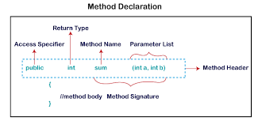
User-defined Method
The method written by the user or programmer is known as a user-defined method
We can modify the method according to our requirement.

Slide 136
Access Specifier:
Access specifier or modifier is the access type of the method. It specifies the visibility of the method. Java provides four types of access specifier:
Public: The method is accessible by all classes when we use public specifier in our application.
Private: When we use a private access specifier, the method is accessible only in the classes in which it is defined.
Protected: When we use protected access specifier, the method is accessible within the same package or subclasses in a different package.
Default: When we do not use any access specifier in the method declaration, Java uses default access specifier by default. It is visible only from the same package only.

Slide 137
Return Type:
Return type is a data type that the method returns.
If the method does not return anything, we use void keyword.
Method Name:
It is a unique name that is used to define the name of a method.
A method is invoked by its name.
Parameter List:
It is the list of parameters separated by a comma and enclosed in the pair of parentheses. It contains the data type and variable name. If the method has no parameter, left the parentheses blank.
Method Body: It is a part of the method declaration. It contains all the actions to be performed. It is enclosed within the pair of curly braces.

Slide 138
class Example
{
public static void main(String[] args)
{
int a = 15;
int b = 5;
Example e=new Example();
int c = e.minNumber(a, b);
System.out.println("Minimum Value = " + c);
}
public int minNumber(int n1, int n2)
{
int min;
if (n1 > n2)
min = n2;
else
min = n1;
return min;
}
}

Slide 139
Object oriented programming
Lecture #17: Constructors

Slide 140
Constructors
A constructor initializes an object when it is created.
we use a constructor to give initial values to the instance variables defined by the class, or to perform any other start-up procedures
It has the same name as the class in which it resides.
It is syntactically similar to a method
At the time of calling constructor, memory for the object is allocated in the memory.
Every time an object is created using the new() keyword, at least one constructor is called.
It calls a default constructor if there is no constructor available in the class. In such case, Java compiler provides a default constructor by default(initializes all member variables to zero)
Once we define our own constructor, the default constructor is no longer used.

Slide 141
Constructors
Rules for creating Java constructor
Constructor name must be the same as its class name
A Constructor must have no explicit return type
A Java constructor cannot be abstract, static, final, and synchronized
There are two types of constructors in Java:
No-arguments constructor
Parameterized constructor
Syntax:
class ClassName
{
ClassName()
{
}
}

Slide 142
No-arguments constructor
No argument constructors of Java does not accept any parameters.
Instance variables of a method will be initialized with fixed values for all objects.
Syntax:
class ClassName {
ClassName()
{
var_name=value;
}
}
Example:
Public class MyClass
{
Int num;
MyClass()
{
num = 10;
}
}
class Example
{
public static void main(String args[])
{
MyClass o1 = new MyClass();
MyClass o2 = new MyClass();
System.out.println(o1.num + " " + o2.num);
}
}
Output:
10 10

Slide 143
Parameterized constructor
The parameterized constructor is used to provide different values to distinct objects. However, you can provide the same values also.
Accepts one or more parameters
Parameters are added to a constructor in the same way that they are added to a method
Example:
class MyClass
{
int x;
MyClass(int i )
{
x = i;
}
}
class Example
{
public static void main(String args[])
{
MyClass o1 = new MyClass(10);
MyClass o2 = new MyClass(20);
System.out.println(o1.num + " " + o2.num);
}
}
Syntax:
class ClassName {
ClassName(parameters )
{
var_name=value;
}
}
Output: 10 20

Slide 144
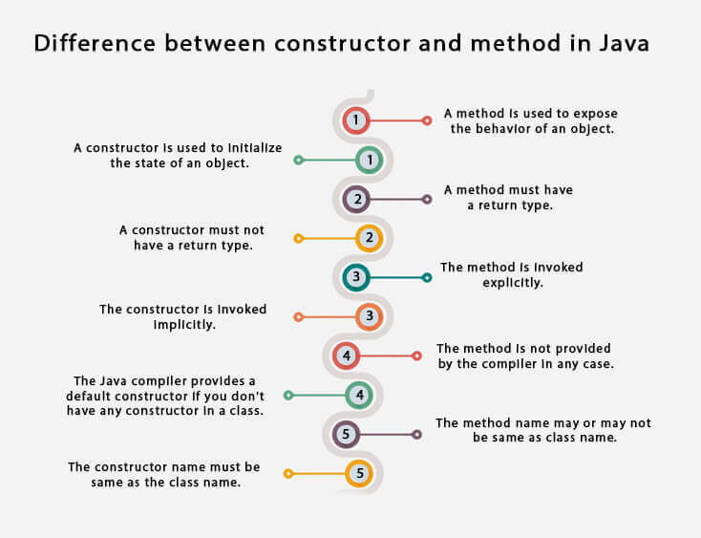
Constructors vs methods

Slide 145
Object oriented programming
Lecture #18: Constructor Overloading

Slide 146
Constructor Overloading
It is a technique of having more than one constructor with different parameter lists.
Each constructor performs a different task.
They are differentiated by the compiler by the number of parameters in the list and their types.

Slide 147
class Student{
int id;
String name;
int age;
Student(int i,String n)
{
id = i;
name = n;
}
Student(int i,String n,int a)
{
id = i;
name = n;
age=a;
}
void display(){System.out.println(id+" "+name+" "+age);}
public static void main(String args[]){
Student s1 = new Student(11,"Jyothi");
Student s2 = new Student(22,"Rama",25);
s1.display();
s2.display();
}
}
Output:
11 jyothi 0
22 Rama 25

Slide 148
Object oriented programming
Lecture #19: Method Overloading

Slide 149
Method Overloading
polymorphism means many forms.
Method overloading is one of the ways through which java supports polymorphism.
Polymorphism in Java is a concept by which we can perform a single action in different ways.
There are two types of polymorphism in Java: compile-time polymorphism and runtime polymorphism. We can perform polymorphism in java by method overloading and method overriding.
Compile Time Polymorphism: At compile-time, java knows which method to call by checking the method signatures. So this is called compile-time polymorphism or static or early binding. Compile-time polymorphism is achieved through method overloading.

Slide 150
Method Overloading
Method Overloading is a technique which allows declaring multiple methods with same name but different parameters in the same class.
They are differentiated by the compiler by changing number of arguments or by changing the data type of arguments.
If two or more method have same name and same parameter list but differs in return type can not be overloaded.
There are two different ways of method overloading.
Different datatype of arguments
Different number of arguments

Slide 151
Method overloading by changing data type of arguments.
You can see that sum() method is overloaded two times. The first takes two integer arguments, the second takes two float arguments.
class Calculate
{
void sum (int a, int b)
{
System.out.println("sum is"+(a+b)) ;
}
void sum (float a, float b)
{
System.out.println("sum is"+(a+b));
}
Public static void main (String[] args)
{
Calculate cal = new Calculate();
cal.sum (8,5); //sum(int a, int b) is method is called.
cal.sum (4.6f, 3.8f); //sum(float a, float b) is called.
}
}

Slide 152
Method overloading by changing no. of argument
class Demo
{
void multiply(int l, int b)
{
System.out.println("Result is"+(l*b)) ;
}
void multiply(int l, int b,int h)
{
System.out.println("Result is"+(l*b*h));
}
public static void main(String[] args)
{
Demo a = new Demo();
a.multiply(8,5); //multiply(int l, int b) is method is called
a.multiply(4,6,2); //multiply(int l, int b,int h) is called
}
}
multiply() method is overloaded twice. The first method takes two arguments and the second method takes three arguments.

Slide 153
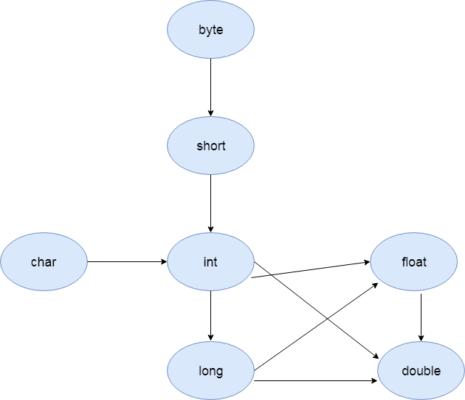
Method Overloading and Type Promotion
One type is promoted to another implicitly if no matching datatype is found.

Slide 154
Method Overloading and Type Promotion
class Example
{
void sum(int a,long b)
{
System.out.println(a+b);
}
void sum(int a,int b,int c)
{
System.out.println(a+b+c);
}
public static void main(String args[])
{
Example obj=new Example();
obj.sum(20,20);//now second int literal will be promoted to long
obj.sum(20,20,20);
}
}
Output:40
60

Slide 155
Method Overloading and Type Promotion
class Example
{
void sum(int a,int b)
{
System.out.println(a+b);
}
void sum(long a,long b)
{
System.out.println(a+b);
}
public static void main(String args[])
{
Example obj=new Example();
obj.sum(20,20);//now int arg sum() method gets invoked
}
}
Output:20
20

Slide 156
Method Overloading and Type Promotion
class Example
{
void sum(int a,long b)
{
System.out.println("a method invoked");
}
void sum(long a,int b)
{
System.out.println("b method invoked");
}
public static void main(String args[])
{
Example obj=new Example();
obj.sum(20,20);//now ambiguity
}
}
Output: Compile Time Error

Slide 157
Object oriented programming
Lecture #20: “this” Keyword

Slide 158
Usage of java this keyword
This can be used to refer current class instance variable.
This can be used to refer current class method (implicitly)
this() can be used to invoke current class constructor.

Slide 159
this can be used to refer current class instance variable.
The this keyword can be used to refer current class instance variable. If there is ambiguity between the instance variables and parameters, this keyword resolves the problem of ambiguity.

Slide 160
Understanding the problem without this keyword
class Student{
int rollno;
String name;
float fee;
Student(int rollno,String name,float fee){
rollno=rollno;
name=name;
fee=fee;
}
void display(){System.out.println(rollno+" "+name+" "+fee);}
}
class TestThis1{
public static void main(String args[]){
Student s1=new Student(111,"ankit",5000f);
Student s2=new Student(112,"sumit",6000f);
s1.display();
s2.display(); }}
Here, parameters (formal arguments) and instance variables are same. So, we are using this keyword to distinguish local variable and instance variable.
Output:
0 null 0.0
0 null 0.0

Slide 161
Solution of the above problem by this keyword
class Student{
int rollno;
String name;
float fee;
Student(int rollno,String name,float fee){
this.rollno=rollno;
this.name=name;
this.fee=fee;
}
void display(){System.out.println(rollno+" "+name+" "+fee);}
}
class TestThis2{
public static void main(String args[]){
Student s1=new Student(111,"ankit",5000f);
Student s2=new Student(112,"sumit",6000f);
s1.display();
s2.display(); }}
If local variables(formal arguments) and instance variables are different, there is no need to use this keyword
Output:
111 ankit 5000
112 sumit 6000

Slide 162
Program where this keyword is not required
class Student{
int rollno;
String name;
float fee;
Student(int r,String n,float f){
rollno=r;
name=n;
fee=f;
}
void display(){System.out.println(rollno+" "+name+" "+fee);}
}
class TestThis3{
public static void main(String args[]){
Student s1=new Student(111,"ankit",5000f);
Student s2=new Student(112,"sumit",6000f);
s1.display();
s2.display(); }}
Output:
111 ankit 5000
112 sumit 6000

Slide 163
this: to invoke current class method
You may invoke the method of the current class by using the this keyword. If you don't use the this keyword, compiler automatically adds this keyword while invoking the method.

Slide 164
Example
class A
{
void m()
{
System.out.println("hello m");
}
void n()
{
System.out.println("hello n");
this.m();
}
}
class TestThis4{
public static void main(String args[]){
A a=new A();
a.n();
}}
Output:
hello n
hello m

Slide 165
this() : to invoke current class constructor
The this() constructor call can be used to invoke the current class constructor. It is used to reuse the constructor. In other words, it is used for constructor chaining.

Slide 166
Calling default constructor from parameterized constructor:
class A
{
A()
{
System.out.println("hello a");
}
A(int x)
{
this();
System.out.println(x);
}
}
class TestThis5
{
public static void main(String args[])
{
A a=new A(10);
}
}
Default constructor
Output:
hello a
10

Slide 167
Calling parameterized constructor from default constructor:
class A{
A(){
this(5);
System.out.println("hello a");
}
A(int x){
System.out.println(x);
}
}
class TestThis6{
public static void main(String args[]){
A a=new A();
}}
Parameterized constructor
Output:
5
hello a

Slide 168
Example
class Student
{
int rollno;
String name,course;
float fee;
Student(int rollno,String name,String course)
{
this.rollno=rollno;
this.name=name;
this.course=course;
}
Student(int rollno,String name,String course,float fee)
{
this(rollno,name,course);//reusing constructor
this.fee=fee;
}
void display(){System.out.println(rollno+" "+name+" "+course+" "+fee);}
}
class TestThis7{
public static void main(String args[]){
Student s1=new Student(111,"ankit","java");
Student s2=new Student(112,"sumit","java",6000f);
s1.display();
s2.display();
}
}
Output:
111 ankit java null
112 sumit java 6000

Slide 169
Object oriented programming
Lecture #21: “static” Keyword

Slide 170
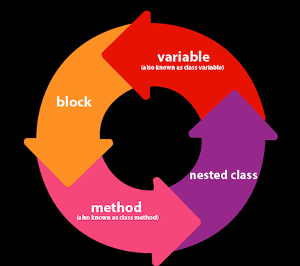
“static” Keyword
The static keyword in Java is used for memory management mainly.
The static keyword belongs to the class than an instance of the class.
The “static” Keyword can be applied to:
Variable (also known as a instance variable)
Block
Method
Nested class

Slide 171
to varibale
Java static variable:
If you declare any variable as static, it is known as a static variable.
The static variable can be used to refer to the common property of all objects (which is not unique for each object)
for example: college name of students
The static variable gets memory only once in the class area at the time of class loading
It makes your program memory efficient (i.e., it saves memory).
Syntax:
static varibale_name=value;

Slide 172
to varibale
class Student{
int rollno;
String name;
String college="CHRIST";
}
If we make college filed static, this field will get the memory only once.
class Student{
int rollno;
String name;
static String college="CHRIST";
}
Java static property is shared to all objects.

Slide 173
to varibale
class Student{
int rollno;
String name;
static String college ="CHRIST";//static variable
Student(int r, String n){
rollno = r;
name = n;
}
void display (){System.out.println(rollno+" "+name+" "+college);}
}
public class TestStaticVariable1{
public static void main(String args[]){
Student s1 = new Student(111,"Jyothi");
Student s2 = new Student(222,"Mandala");
s1.display();
s2.display();
}
}
Output:
111 Jyothi CHRIST
222 Mandala CHRIST

Slide 174
to varibale
class Counter{
int count=0;//will get memory each time when the instance is created
Counter(){
count++;//incrementing value
System.out.println(count);
}
public static void main(String args[]){
//Creating objects
Counter c1=new Counter();
Counter c2=new Counter();
Counter c3=new Counter();
}
}
Output:
1
1
1

Slide 175
to varibale
will get memory only once and retain its value
class Counter2{
static int count=0;
Counter2(){
count++;//incrementing the value of static variable
System.out.println(count);
}
public static void main(String args[]){
//creating objects
Counter2 c1=new Counter2();
Counter2 c2=new Counter2();
Counter2 c3=new Counter2();
}
}
Output:
1
2
3

Slide 176
TO BLOCK
A static block is used for initializing static variables.
The static block is executed once when the first object of the class is created.
Syntax:
static
{
//code
}

Slide 177
to BLOCK
class Example {
static int a;
static int b;
static {
a = 10;
b = 2 * a;
}
public static void main( String args[] )
{
Example e = new Example();
System.out.printf("a = %d\t b = %d ", e.a, e.b);
}
}
Output:
a = 10 b = 20

Slide 178
Object oriented programming
Lecture #22: “static” Keyword(cont.)

Slide 179
“static” Keyword
The static keyword in Java is used for memory management mainly.
The static keyword belongs to the class than an instance of the class.
The “static” Keyword can be applied to:
Variable (also known as a instance variable)
Block
Method
Nested class

Slide 180
to method
If you apply static keyword with any method, it is known as static method.
A static method belongs to the class rather than the object of a class.
A static method can be invoked without the need for creating an instance of a class.
A static method can access static data member and can change the value of it.
class Student{
int rollno;
String name;
static String college = "CHRIST";
//static method to change the value of static variable
static void change(){
college = "SOET";
}

Slide 181
to method
class Calculate{
static int cube(int x){
return x*x*x;
}
public static void main(String args[])
{
int result=Calculate.cube(5);
System.out.println(result);
}
}
Output:
125

Slide 182
to method
Restrictions for the static method
The static method can not use non static data member or call non-static method directly.
this and super cannot be used in static context.
Java main method is static? because the object is not required to call a static method. If it were a non-static method, JVM creates an object first then call main() method that will lead the problem of extra memory allocation.
class A{
int a=40;//non static
public static void main(String args[]){
System.out.println(a);
}
}
Output:
Compile Time Error

Slide 183
Object oriented programming
Lecture #23: Inheritance-Introduction

Slide 184
Inheritance
Inheritance can be defined as the process where one class acquires the properties (methods and fields) of another.
Reusability is achieved by INHERITANCE
Java classes Can be Reused by extending a class. Extending an existing class is nothing but reusing properties of the existing classes.
The class whose properties are extended is known as super or base or parent class.
The class which extends the properties of super class is known as sub or derived or child class
A class can either extends another class or can implement an interface

Slide 185
Defining a Subclass
Syntax :
class <subclass name> extends <superclass name>
{
variable declarations;
method declarations;
}
extends keyword signifies that properties of the super class are extended to sub class
Sub class will not inherit private members of super class

Slide 186
Inheritance
class B extends A { ….. }
A super class
B sub class
A
<<class>>
B
<<class>>
A
<<interface>>
class B implements A { ….. }
A interface
B sub class
B
<<class>>

Slide 187
TYPES OF INHERITANCE
Single Inheritance
Hierarchical Inheritance
A
A
X
X
B
B
A
B
C
A
B
C
NOT SUPPORTED BY JAVA
MultiLevel Inheritance
Multiple Inheritance
SUPPORTED BY JAVA
A
A
A
B
A
B
B
B
C
C
C
C

Slide 188
TYPES OF INHERITANCE
Mulitiple Inheritance can be implemented by implementing multiple interfaces not by extending multiple classes
Example :
class Z extends A implements C , D
{ …………}
OK
class Z extends A ,B class Z extends A extends B
{ {
OR
} }
A
C
D
Z
WRONG
WRONG

Slide 189
Object oriented programming
Lecture #24: Single Inheritance

Slide 190
Inheritance
Inheritance can be defined as the process where one class acquires the properties (methods and fields) of another.
Reusability is achieved by INHERITANCE
Java classes Can be Reused by extending a class. Extending an existing class is nothing but reusing properties of the existing classes.
The class whose properties are extended is known as super or base or parent class.
The class which extends the properties of super class is known as sub or derived or child class
A class can either extends another class or can implement an interface

Slide 191
TYPES OF INHERITANCE
Single Inheritance
A
A
B
B

Slide 192
Single Inheritance
class A
{
int i,j;
void showij()
{
System.out.println(“i and j : “+i+j);
}
}
class B extends A
{
int k;
void showk()
{
System.out.println(“k : “+k);
}
void sum()
{
System.out.println(“i+j+k: “+(i+j+k));
}
}
class Example
{
public static void main(String args[])
{
A a = new A();
B b = new B();
a.i=10;
a.j=20;
System.out.println(“contents of a:”);
a.showij();
b.i=1;
b.j=2;
b.k=3;
System.out.println(“contents of b:”);
b.showij();
b.showk();
System.out.println(“sum of i,j,k of b:”);
b.sum();
}
}
Output:
1
1
1

Slide 193
Object oriented programming
Lecture #25: Multilevel Inheritance

Slide 194
Inheritance
Inheritance can be defined as the process where one class acquires the properties (methods and fields) of another.
Reusability is achieved by INHERITANCE
Java classes Can be Reused by extending a class. Extending an existing class is nothing but reusing properties of the existing classes.
The class whose properties are extended is known as super or base or parent class.
The class which extends the properties of super class is known as sub or derived or child class
A class can either extends another class or can implement an interface

Slide 195
TYPES OF INHERITANCE
MultiLevel Inheritance
A
A
B
B
C
C

Slide 196
multi lvel Inheritance
class C extends B
{
int k;
void showk()
{
System.out.println(“k : “+k);
}
void sum()
{
System.out.println(“i+j+k: “+(i+j+k));
}
}
class Example
{
public static void main(String args[]) {
C c=new C();
c.i=10;
c.j=20;
c.k=30;
c.sum()
}}
class A
{
int i;
void showij()
{
System.out.println(“i :”+i);
}
}
class B extends A
{
int j;
void showj()
{
System.out.println(“j : “+j);
}
}
Output:
1
1
1

Slide 197
Object oriented programming
Lecture #26: Hierarchical Inheritance

Slide 198
Inheritance
Inheritance can be defined as the process where one class acquires the properties (methods and fields) of another.
Reusability is achieved by INHERITANCE
Java classes Can be Reused by extending a class. Extending an existing class is nothing but reusing properties of the existing classes.
The class whose properties are extended is known as super or base or parent class.
The class which extends the properties of super class is known as sub or derived or child class
A class can either extends another class or can implement an interface

Slide 199
TYPES OF INHERITANCE
Hierarchical Inheritance
X
X
A
B
C
A
B
C

Slide 200
Hierarchical Inheritance
class A
{
int i;
void showij()
{
System.out.println(“i :”+i);
}
}
class B extends A
{
int j;
void showj()
{
System.out.println(“j : “+j);
}
void sum()
{
System.out.println(“i+j: “+(i+j));
}
}
class C extends A{
int k;
void showk()
{
System.out.println(“k : “+k);
}
void sum()
{
System.out.println(“i+k: “+(i+k));
}
}
class Example
{
public static void main(String args[]) {
C c=new C();
c.i=10;
c.k=30;
c.sum()
}}
Output:
1
1
1

Slide 201
Object oriented programming
Lecture #27: “super” keyword

Slide 202
super Keyword
The super keyword in Java is used in subclasses to access superclass members (attributes, constructors and methods).
Can be used to call super class constrctor
1. super()
2. super(<parameter-list>)
Can refer to super class instance variables/Methods
3. super . <super class instance variable/Method>

Slide 203
USE OF super KEYWORD for constructors
Whenever a sub class object is created ,super class constructor is called first.
If super class constructor does not have any constructor of its own OR has an unparametrized constructor then it is automatically called by Java Run Time by using call super()
If a super class has a parameterized constructor then it is the responsibility of the sub class constructor to call the super class constructor by call
super(<parameters required by super class>)
Call to super class constructor must be the first statement in sub class constructor

Slide 204
1. When super class has a Unparametrized constructor
class A
{
A()
{
System.out.println("This is constructor
of class A");
}
} // End of class A
class B extends A
{
B()
{
super();
System.out.println("This is constructor of class B”);}
} // End of class B
class inhtest
{
public static void main(String args[])
{
B b1 = new B();
}
}
Optional
OUTPUT
This is constructor of class A
This is constructor of class B

Slide 205
class A
{
A()
{
System.out.println("This is class A");
}
}
class B extends A
{
B()
{
System.out.println("This is class B");
}
}
class inherit1
{
public static void main(String args[])
{
B b1 = new B();
}
}
File Name is inherit1.java
Output:
This is class A
This is class B
1. When super class has a Unparametrized constructor

Slide 206
1. When super class has a Unparametrized constructor
class A
{
private A()
{
System.out.println("This is class A");
}
}
class B extends A
{
B()
{
System.out.println("This is class B");
}
}
class inherit2
{
public static void main(String args[])
{
B b1 = new B();
}
}
Output:
Error: A() has private access in A

Slide 207
class A
{
private A()
{
System.out.println("This is class A");
}
A()
{
System.out.println("This is class A");
}
}
class B extends A
{
B()
{
System.out.println("This is class B");
}
}
class inherit2
{
public static void main(String args[])
{
B b1 = new B();
} }
Output:
A() is already defined in A
A() has private access in A
2 errors
1. When super class has a Unparametrized constructor

Slide 208
2. When super class has a parametrized constructor
class A
{
int a;
A( int a1)
{
a =a1;
System.out.println("This is constructor of class A");
}
}
class B extends A
{
int b;
double c;
B(int b1,double c1)
{
b=b1;
c=c1;
System.out.println("This is constructor of class B");
}
}
B b1 = new B(10,8.6);
D:\java\bin>javac inhtest.java
inhtest.java:15: cannot find symbol
symbol : constructor A()
location: class A
{
^
1 errors

Slide 209
class A
{
int a;
A( int a1)
{
a =a1;
System.out.println("This is constructor of class A");
} }
class B extends A
{
int b;
double c;
B(int a2,int b1,double c1)
{
super(a2);
b=b1;
c=c1;
System.out.println("This is constructor of class B");
} }
2. When super class has a parametrized constructor
B b1 = new B(8,10,8.6);
OUTPUT
This is constructor of class A
This is constructor of class B

Slide 210
Object oriented programming
Lecture #28: “super” keyword

Slide 211
super Keyword
The super keyword in Java is used in subclasses to access superclass members (attributes, constructors and methods).
Can be used to call super class constrctor
1. super()
2. super(<parameter-list>)
Can refer to super class instance variables/Methods
3. super . <super class instance variable/Method>

Slide 212
3. Refer to super class instance variables/Methods
class A
{
int a;
A( int a)
{
this.a =a;
System.out.println("This is constructor of class A");
}
void print()
{
System.out.println("a="+a);
}
void display()
{
System.out.println("hello This is Display in A");
}
} // End of class A
class B extends A
{
int b;
double c;
B(int a,int b,double c)
{
super(a);
this.b=b;
this.c=c;
System.out.println("This is constructor of class B");
}
void show()
{
print();
System.out.println("b="+b);
System.out.println("c="+c);
}
} // End of class B

Slide 213
3. Refer to super class instance variables/Methods
class inhtest1
{
public static void main(String args[])
{
B b1 = new B(10,8,4.5);
b1.show();
}
}
OutPut
D:\java\bin>java inhtest1
This is constructor of class A
This is constructor of class B
a=10
b=8
c=4.5

Slide 214
3. Refer to super class instance variables/Methods
class A
{
int a;
A( int a)
{
this.a =a;
System.out.println("This is constructor of class A");
}
void show()
{
System.out.println("a="+a);
}
void display()
{
System.out.println("hello This is Display in A");
}
}
class B extends A
{
int b;
private double c;
B(int a,int b,double c)
{
super(a);
this.b=b;
this.c=c;
System.out.println("This is constructor of class B");
}
void show()
{
super.show();
System.out.println("b="+b);
System.out.println("c="+c);
display();
}
}

Slide 215
3. Refer to super class instance variables/Methods
class inhtest1
{
public static void main(String args[])
{
B b1 = new B(10,8,4.5);
b1.show();
}
}
/* OutPut
D:\java\bin>java inhtest1
This is constructor of class A
This is constructor of class B
a=10
b=8
c=4.5
hello This is Display in A
*/

Slide 216
class A
{
int a;
A( int a)
{
this.a =a;
}
void show()
{
System.out.println("a="+a);
}
void display()
{
System.out.println("hello This is
Display in A");
}
}
class B extends A
{
int b;
double c;
B(int a,int b,double c)
{
super(a);
this.b=b;
this.c=c;
}
void show()
{
//super.show();
System.out.println("a="+a);
System.out.println("b="+b);
System.out.println("c="+c);
}
}
class inhtest2
{
public static void main(String
args[])
{
B b1 = new B(10,20,8.4);
b1.show();
}
}
D:\java\bin>java inhtest2
a=10
b=20
c=8.4
3. Refer to super class instance variables/Methods

Slide 217
class B extends A
{
// super class variable a hides here
int a;
int b;
double c;
B(int a,int b,double c)
{
super(100);
this.a = a;
this.b=b;
this.c=c;
}
void show()
{
System.out.println("Super class a="+super.a);
System.out.println("a="+a);
System.out.println("b="+b);
System.out.println("c="+c);
}
}
class A
{
int a;
A( int a)
{
this.a =a;
}
}
class inhtest2
{
public static void main(String args[])
{
B b1 = new B(10,20,8.4);
b1.show();
}
}
Out Put
D:\java\bin>java inhtest2
Super class a=100
a=10
b=20
c=8.4
3. Refer to super class instance variables/Methods

Slide 218
Object oriented programming
Lecture #29: Method Overriding

Slide 219
Method Overriding
If subclass (child class) has the same method as declared in the parent class, it is known as method overriding in Java.
Uses:
Method overriding is used to provide the specific implementation of a method which is already provided by its superclass.
Method overriding is used for runtime polymorphism
Rules for Java Method Overriding
The method must have the same name as in the parent class
The method must have the same parameter as in the parent class.

Slide 220
Method Overriding
class Vehicle
{
void run()
{
System.out.println("Vehicle is running");
}
}
class Vehicle
{
void run()
{
System.out.println("Vehicle is running");
}
}
class Bike extends Vehicle
{
public static void main(String args[])
{
Bike obj = new Bike();
obj.run();
}
}
class Bike extends Vehicle
{
public static void main(String args[])
{
Bike obj = new Bike();
obj.run();
}
void run()
{
System.out.println("Bike is running safely");
}
}
Output:
Vehicle is running
Output:
Bike is running safely

Slide 221
Method Overriding
class Vehicle
{
void run()
{
System.out.println("Vehicle is running");
}
}
class Vehicle
{
void run()
{
System.out.println("Vehicle is running");
}
}
class Bike extends Vehicle
{
public static void main(String args[])
{
Bike obj = new Bike();
obj.run();
}
}
class Bike extends Vehicle
{
public static void main(String args[])
{
Bike obj = new Bike();
obj.run();
}
void run()
{
super.run();
System.out.println("Bike is running safely");
}
}
Output:
Vehicle is running
Output:
Vehicle is running
Bike is running safely

Slide 222
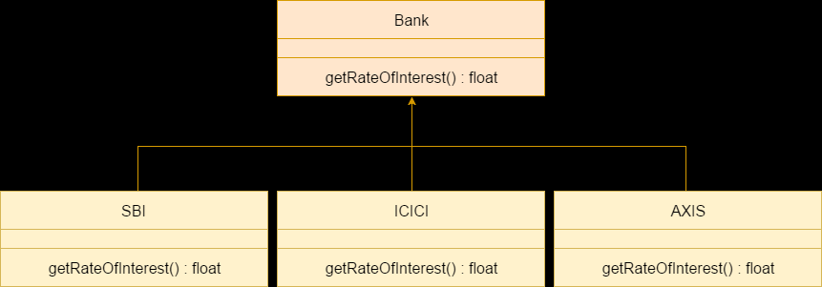
Method Overriding realtime example
Example

Slide 223
Method Overriding
Note:
A method declared as static method cannot be overridden
Main method cannot be overridden
A method declared final cannot be overridden.
Constructors cannot be overridden.

Slide 224
method Overloading vs Method Overriding

Slide 225
Object oriented programming
Lecture #30: Dynamic Method Dispatch

Slide 226

Example

Slide 227
Object oriented programming
Lecture #31: “final” keyword

Slide 228
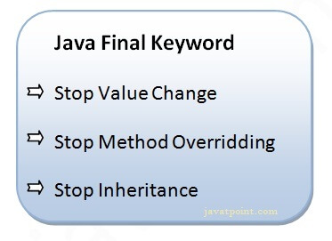
“final” keyword
The final keyword in java is used to restrict the user
final can be:
variable
method
class

Slide 229
Java final variable
If you make any variable as final, you cannot change the value of final variable(It will be constant).
class Bike
{
final int speedlimit=90;//final variable
void run()
{
speedlimit=400; // error
}
public static void main(String args[])
{
Bike obj=new Bike();
obj.run();
}
}//end of class
class FinalVariable
{
final int var = 50;
var = 60 // error
}
compile-time errors

Slide 230
Java final method
class Bike
{
final void run()
{
System.out.println("running");
}
}
class Honda extends Bike
{
void run()
{System.out.println("running safely with 100kmph");}
public static void main(String args[])
{
Honda honda= new Honda();
honda.run();
}
}
If you make any method as final, you cannot override it.
compile-time errors

Slide 231
Java final class
final class Bike
{
....
}
class Honda1 extends Bike
{
void run()
{
System.out.println("running safely with 100kmph");
}
public static void main(String args[])
{
Honda1 honda= new Honda1();
honda.run();
}
}
If you make any class as final, you cannot extend it.
compile-time errors

Slide 232
“final” keyword
uninitialized final variable:
A final variable that is not initialized at the time of declaration is known as blank final variable.
It can be initialized only in constructor.
Ex: PANCARD NUMBER
class Bike{
final int speedlimit;//blank final variable
Bike()
{
speedlimit=70;
System.out.println(speedlimit);
}
public static void main(String args[])
{
Bike b1=new Bike();
}
}

Slide 233
“final” keyword
static blank final variable
A static final variable that is not initialized at the time of declaration is known as static blank final variable.
It can be initialized only in static block.
class A
{
static final int data;//static blank final variable
static
{
data=50;
}
public static void main(String args[])
{
System.out.println(A.data);
}
}

Slide 234
“final” keyword
final parameter
If you declare any parameter as final, you cannot change the value of it.
class Bike
{
int cube(final int n)
{
n=n+2;//can't be changed as n is final
n*n*n;
}
public static void main(String args[])
{
Bike b=new Bike();
b.cube(5);
}
}
compile-time errors

Slide 235
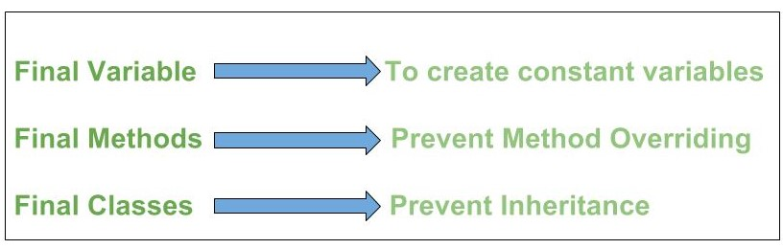
“final” keyword

Slide 236
Object oriented programming
Lecture #32: Abstract class

Slide 237
Abstraction
Abstraction is a process of hiding the implementation details and showing only functionality to the user.
There are two ways to achieve abstraction in java
Abstract class
Interface

Slide 238
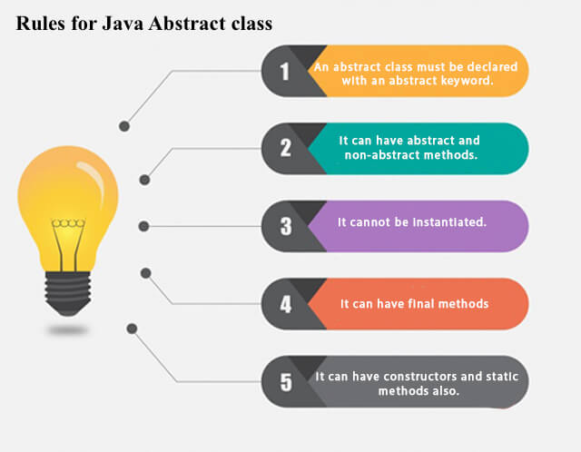
Abstract Class
A class which contains the abstract keyword in its declaration is known as abstract class.

Slide 239
Abstract Class
An abstract class can have both abstract and regular methods
The abstract keyword is a non-access modifier, used for classes and methods:
Abstract class: is a restricted class that cannot be used to create objects (to access it, it must be inherited from another class).
Abstract method: can only be used in an abstract class, and it does not have a body. The body is provided by the subclass (inherited from).
Syntax:
abstract class_name{ }
no method body
Syntax:
abstract type method_name(paramenter_list);

Slide 240
abstract class Figure
{
int dim1,dim2;
Figure(int d1, int d2)
{
dim1=d1;
dim2=d2;
}
void display()
{
System.out.println(“Area is: “);
}
abstract void area(); //abstract method
}
class Rectangle extends Figure
{
Rectangle(int a, int b)
{
super(a,b);
}
void area() //overriding abstract method
{
System.out.println(dim1*dim2);
}
}
class Example32{
public static void main(String args[])
{
Rectangle r=new rectangle(10,20);
Figure f;
f=r;
f.display();
f.area();
}
}
Any subclass of an abstract class must either implement all of the abstract methods of super class or be declared itself aabstract

Slide 241
Object oriented programming
Lecture #33: Interface

Slide 242
Abstraction
Abstraction is a process of hiding the implementation details and showing only functionality to the user.
There are two ways to achieve abstraction in java
Abstract class
Interface

Slide 243
Interface
An interface is a fully abstract class. It includes a group of abstract methods (methods without a body).
We use the “interface” keyword to create an interface in Java
Uses:
It is used to achieve abstraction.
By interface, we can support the functionality of multiple inheritance.
Syntax:
interface <interface_name>{
// declare constant fields
// declare methods that abstract
// by default.
}

Slide 244
interface
Implementing an Interface
Like abstract classes, we cannot create objects of interfaces.
To use an interface, other classes must implement it. We use the “implements” keyword to implement an interface.
Note:
It is similar to class. It is a collection of abstract methods.
Method bodies exist only for default methods and static methods.
An interface may also contain constants, default methods, static methods, and nested types.
all the methods of the interface need to be defined in the class.
cannot instantiate an interface.
does not contain any constructors.

Slide 245
interface Polygon
{
void getArea(int length, int breadth);
}
class Rectangle implements Polygon
{
public void getArea(int length, int breadth)
{
System.out.println("The area of the rectangle is " + (length * breadth));
}
}
class Example{
public static void main(String[] args) {
Rectangle r1 = new Rectangle();
r1.getArea(5, 6);
}
}
A class that implements an interface must implement all the methods declared in the interface.

Slide 246
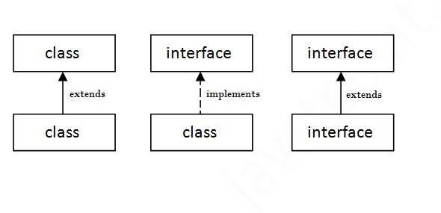
interface
The relationship between classes and interfaces

Slide 247
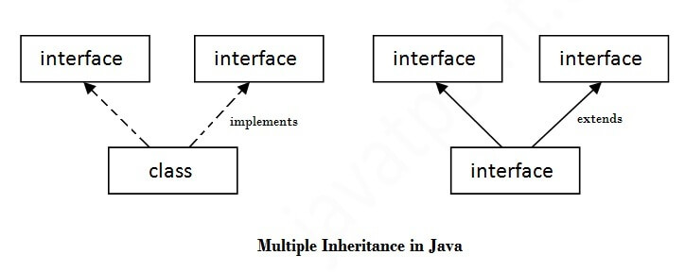
interface
Multiple inheritance in Java by interface

Slide 248
interface
if any class implements Polygon, it should provide implementations for all the abstract methods of both Line and Polygon.
Implementing Multiple Interfaces
Extending an Interface
interface A {
// members of A
}
interface B {
// members of B
}
class C implements A, B {
// abstract members of A
// abstract members of B
}
interface Line {
// members of Line interface
}
// extending interface
interface Polygon extends Line {
// members of Polygon interface
// members of Line interface
}

Slide 250
Object oriented programming
Lecture #34: Object class

Slide 251
object class
The Object class is the parent class of all the classes in java by default
Object class is present in java.lang package
If a Class does not extend any other class then it is direct child class of Object and if extends other class then it is an indirectly derived
The Object class provides some common behaviors to all the objects such as object can be compared, object can be cloned, object can be notified etc.
String toString()
boolean equals(Object obj)
int hashCode()
Object clone()
void finalize()
class getclasss()
void wait()
void notify()
void notifyAll()

Slide 252
equals
It is used to compare the two objects dynamically.
This method returns true if this object is the same as the obj argument; false otherwise.
Syntax:
public boolean equals(Object obj)

Slide 253
Object cloning
The object cloning is a way to create exact copy of an object.
The clone() method of Object class is used to clone an object.
The java.lang.Cloneable interface must be implemented by the class whose object clone we want to create
Advantages:
easy way of copying objects
don't need to write lengthy and repetitive codes.
Syntax:
protected Object clone() throws CloneNotSupportedException

Slide 254
class Student implements Cloneable{
int rollno;
String name;
Student(int rollno,String name){
this.rollno=rollno;
this.name=name;
}
public Object clone()throws CloneNotSupportedException{
return super.clone();
}
public static void main(String args[]){
try{
Student s1=new Student(101,"amit");
Student s2=(Student)s1.clone();
System.out.println(s1.rollno+" "+s1.name);
System.out.println(s2.rollno+" "+s2.name);
}
catch(CloneNotSupportedException c){}
}
}
Output:
101 amit
101 amit

Slide 255
Reflection
Reflection is an API which is used to examine or modify the behavior of methods, classes, interfaces at runtime.
There is a class in Java named “Class” that keeps all the information about objects and classes at runtime.
The object of “Class” can be used to perform reflection.
Steps:
create an object of Class.
using the object we can call various methods to get information about methods, fields, and constructors present in a class.

Slide 256
Reflection
Reflection can be used to get information about –
Class The getClass() method is used to get the name of the class to which an object belongs.
Constructors The getConstructors() method is used to get the public constructors of the class to which an object belongs.
Methods The getMethods() method is used to get the public methods of the class to which an objects belongs.

Slide 257
import java.lang.reflect.Method;
import java.lang.reflect.Field;
import java.lang.reflect.Constructor;
class Test
{
private String s;
public Test() { s = "GeeksforGeeks"; }
public void method1() {
System.out.println("The string is " + s);
}
}
System.out.println("The name of constructor is " + constructor.getName());
System.out.println("The public methods of class are : ");
Method[] methods = cls.getMethods();
System.out.println(method.getName());
}
}
Outpt:
The name of class is Test
The name of constructor is Test
The public methods of class are :
method1
class Demo
{
public static void main(String args[]) throws Exception
{
Test obj = new Test();
Class cls = obj.getClass();
System.out.println("The name of class is " + cls.getName());
Constructor constructor = cls.getConstructor();

Slide 258
Object oriented programming
Lecture #35: Packages

Slide 259
Packages
A Package can be defined as a grouping of related types (classes, interfaces, enumerations and annotations)
Packages are used for:
Preventing naming conflicts.
Making searching/locating and usage of classes, interfaces, enumerations easier
Providing controlled access
Packages can be considered as data encapsulation (or data-hiding).
Package names and directory structure are closely related.

Slide 260
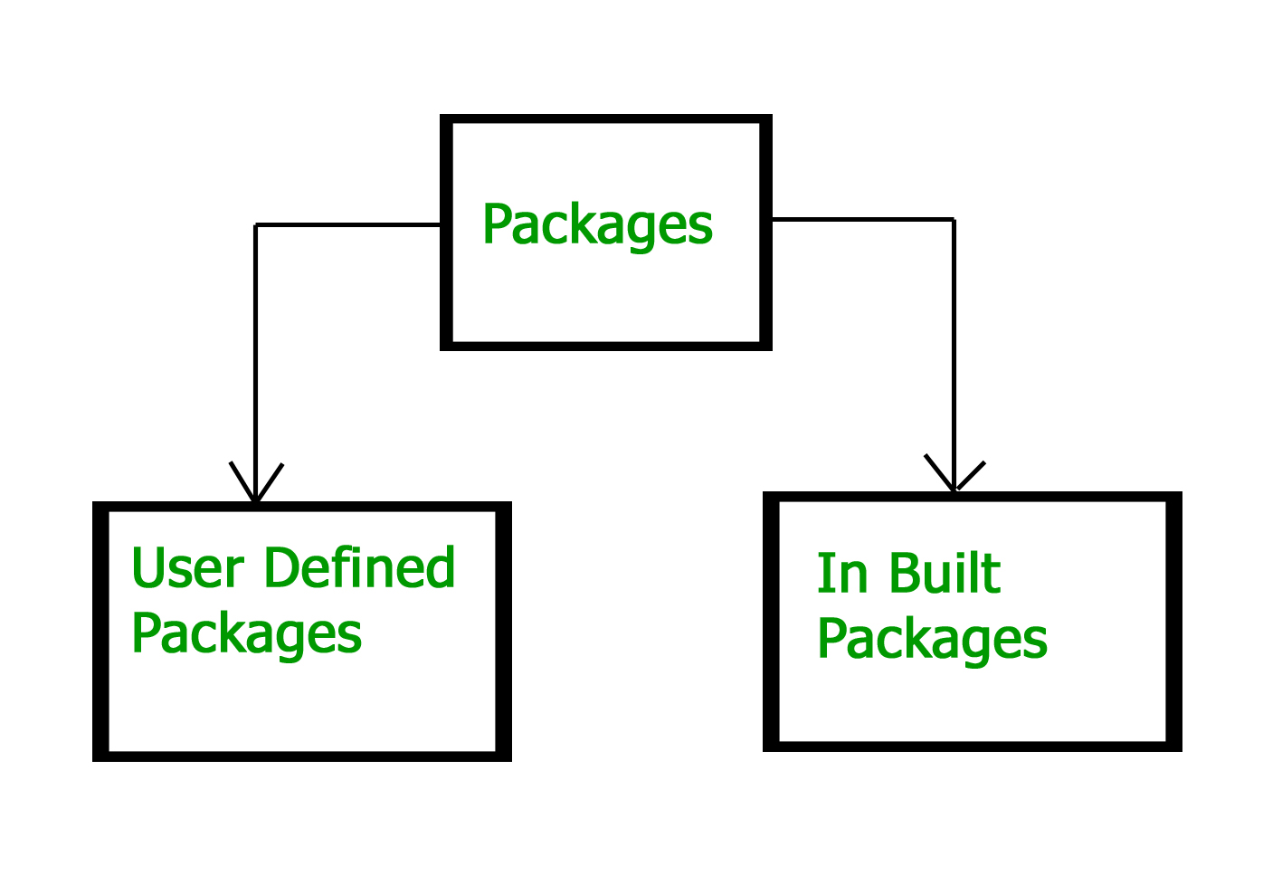
Packages

Slide 261
Built-in Packages
These packages consist of a large number of classes which are a part of Java API.
java.lang: Contains language support classes(e.g classed which defines primitive data types, math operations). This package is automatically imported.
java.io: Contains classed for supporting input / output operations.
java.util: Contains utility classes which implement data structures like Linked List, Dictionary and support ; for Date / Time operations.
java.applet: Contains classes for creating Applets.
java.awt: Contain classes for implementing the components for graphical user interfaces (like button , ;menus etc).
java.net: Contain classes for supporting networking operations.

Slide 262
User-defined packages
It is a good practice to use names of packages with lower case letters to avoid any conflicts with the names of classes and interfaces.
These are the packages that are defined by the user.
Creating a Package:
choose a name for the package
include a “package” statement along with that name
The package statement should be the first line in the source file.
There can be only one package statement in each source file
Example:
package mypack;
public class Simple{
public static void main(String args[]){
System.out.println("Welcome to package");
}
}
Syntax:
package package_name;

Slide 263
User-defined packages
compile java package
run java package program
You need to use fully qualified name
Syntax:
javac -d directory javafilename
Example:
javac -d . Simple.java
The -d switch specifies the destination where to put the generated class file.
Example:
java mypack.Simple

Slide 264
access package from another package
three ways to access
import package.*;
import package.classname;
fully qualified name.

Slide 265
access package from another package
import package.*;
“import” keyword is used to make the classes and interface of another package accessible to the current package.
All the classes and interfaces of this package will be accessible but not subpackages.

Slide 266
save as: A.java
package pack;
public class A{
public void msg(){System.out.println("Hello");}
}
package mypack;
import pack.*;
class B{
public static void main(String args[]){
A obj = new A();
obj.msg();
}
}
save as: B.java
Output:
javac -d . A.java
javac -d . B.java
java mypack.B
Hello

Slide 267
access package from another package
import package.classname;
“import” keyword is used to make the classes and interface of another package accessible to the current package.
only declared class of this package will be accessible.

Slide 268
save as: A.java
package pack;
public class A{
public void msg(){System.out.println("Hello");}
}
package mypack;
import pack.A;
class B{
public static void main(String args[]){
A obj = new A();
obj.msg();
}
}
save as: B.java
Output:
javac -d . A.java
javac -d . B.java
java mypack.B
Hello

Slide 269
access package from another package
fully qualified name.
Now there is no need to import.
But you need to use fully qualified name every time when you are accessing the class or interface.
only declared class of this package will be accessible.

Slide 270
save as: A.java
package pack;
public class A{
public void msg(){System.out.println("Hello");}
}
package mypack;
class B
{
public static void main(String args[])
{
pack.A obj = new pack.A();//using fully qualified name
obj.msg();
}
}
save as: B.java
Output:
javac -d . A.java
javac -d . B.java
java mypack.B
Hello

Slide 271
AcCess Specifiers
Specifies the accessibility or scope of a field, method, constructor, or class.
We can change the access level of fields, constructors, methods, and class by applying the access modifier on it.
By controlling access, you can prevent misuse.
There are four types of Java access modifiers:
Default
public
private
protected

Slide 272
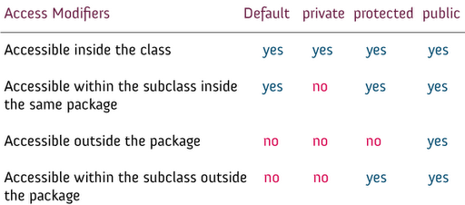
AcCess Specifiers

Slide 273
Object oriented programming
Lecture #36: Graphics Programming

Slide 274
Java Applet
Applet is a special type of program that is embedded in the webpage to generate the dynamic content. It runs inside the browser and works at client side.
Advantage of Applet
It works at client side so less response time.
Secured
It can be executed by browsers running under many plateforms, including Linux, Windows, Mac Os etc.
Applets can perform arithmetic operations, display graphics, play sounds, accepts user inputs, creates animations

Slide 275
Applets
How applets differ from applications:
Applets do not use main() method
Applets cannot run independently. They run inside a webpage using HTML code
Applets cannot read from or write to the files in the local computer
Applet are restricted from using libraries from other languages such as C or C++.
These restrictions ensure security and cannot do any damage to the local system

Slide 276
Applets
Steps involved in developing and testing an applet are:
Building an applet code (.java code)
Creating an executable applet (.class file)
Designing a webpage using HTML tags
Preparing <APPLET> tag
Incorporating <APPET> tag into web page(creating HTML file)
Testing the applet code.

Slide 277
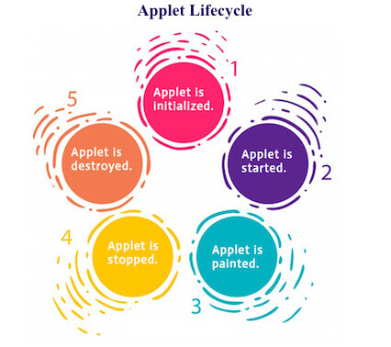
1. Building an Applet
Applet Life cycle:
java.applet.Applet class
For creating any applet java.applet.Applet class must be inherited. It provides 4 life cycle methods of applet.
public void init(): is used to initialized the Applet. It is invoked only once.
public void start(): is invoked after the init() method or browser is maximized. It is used to start the Applet.
public void stop(): is used to stop the Applet. It is invoked when Applet is stop or browser is minimized.
public void destroy(): is used to destroy the Applet. It is invoked only once.
java.awt.Component class
The Component class provides 1 life cycle method of applet.
public void paint(Graphics g): is used to paint the Applet. It provides Graphics class object that can be used for drawing oval, rectangle, arc etc.

Slide 278
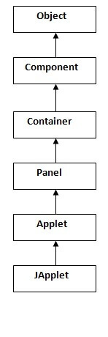
import java.applet.*;
import java.awt.*;
public class appletclassname extends Applet
{
...............
...............
public void paint( Graphics g)
{
............... // Applet operations code
...............
}
...............
...............
}
Hierarchy of Applet------>
import java.applet.*;
import java.awt.*;
public class Helloapplet extends Applet
{
public void paint( Graphics g)
{
g.drawString(“Hello Java”,10,100);
}
}
Helloapplet.java

Slide 279
2. Creating an executable applet (.class file)
.class file is obtained by compiling the source codeof the applet.
this generates Helloapplet.class file.
javac Helloapplet.java

Slide 280
3. Designing a webpage using HTML tags
In order to run a java applet, it is first necessary to have a webpage that references the applet.
Web page is made with HTML tags.
<APPLET> tag is used.
<HTML>
<HEAD>
...
</HEAD>
<BODY>
....
</BODY>
</HTML>

Slide 281
4.Preparing <APPLET> tag
<APPLET> tag supplies the name of the applet to be loaded and tells trowser how much space required by the applet.
This specifies three things
name of the applet
Width of the applet(in pixels)
Height of the applet(in pixels)
Example:
<APPLET
code=Helloapplet.class
width=400
height=200 >
</APPLET>

Slide 282
5. creating HTML file
<HTML>
<HEAD>
<TITLE> Welcome to Java Applets</TITLE>
</HEAD>
<BODY>
<APPLET
code=Helloapplet.class
width=400
height=200 >
</APPLET>
</BODY>
</HTML>
Helloapplet.html

Slide 283
6.Testing the applet code.
Our current directory will have following things:
Helloapplet.java
Helloapplet.class
Helloapplet.html
To run an applet, we require one of the folowing:
java enabled web browser(entire webpage can be seen)
java applet viewer(only applet output)
Syntax:
appletviewer Helloapplet.html

Slide 284
Object oriented programming
Lecture #37: Graphics Programming
(Devoloping and Testing an Applet)

Slide 285
Java Applet
Applet is a special type of program that is embedded in the webpage to generate the dynamic content. It runs inside the browser and works at client side.
Advantage of Applet
It works at client side so less response time.
Secured
It can be executed by browsers running under many plateforms, including Linux, Windows, Mac Os etc.
Applets can perform arithmetic operations, display graphics, play sounds, accepts user inputs, creates animations

Slide 286
Applets
Steps involved in developing and testing an applet are:
Building an applet code (.java code)
Creating an executable applet (.class file)
Designing a webpage using HTML tags
Preparing <APPLET> tag
Incorporating <APPET> tag into web page(creating HTML file)
Testing the applet code.

Slide 287
import java.applet.*;
import java.awt.*;
public class Helloapplet extends Applet
{
public void paint( Graphics g)
{
g.drawString(“Hello Java”,10,100);
}
}
Helloapplet.java
Helloapplet.html
<HTML>
<HEAD>
<TITLE> Welcome to Java Applets</TITLE>
</HEAD>
<BODY>
<APPLET
code=Helloapplet.class
width=400
height=200 >
</APPLET>
</BODY>
</HTML>
Helloapplet.class
javac Helloapplet.java

Slide 288
To run an applet, we require one of the folowing:
java enabled web browser(entire webpage can be seen)
java applet viewer(only applet output)
Syntax:
appletviewer Helloapplet.html
Applet Window------>

Slide 289
working with 2D shapes
Graphics class includes methods for drawing many different types of shapes.
Coordinate System of java
x
(0,0)
(50,0)
 | (0,20)
y
(0,60)
(50,60)

Slide 290
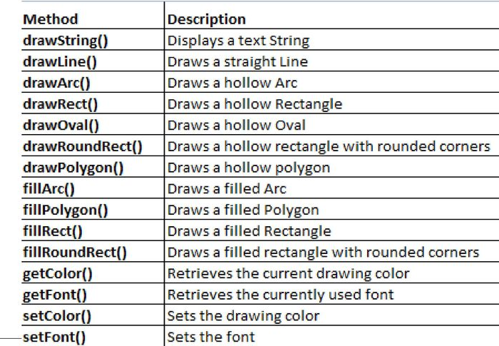
Drawing methods
Graphics class

Slide 291
Object oriented programming
Lecture #38: Nested class/Inner class

Slide 292
Inner class or nested class
In java, just like methods and varibles, it can have a class too.
Java inner class or nested class is a class which is declared inside the class or interface.
Syntax:
class Java_Outer_class{
//code
class Java_Inner_class{
//code
}
}

Slide 293
Inner class or nested class
Types of Nested classes
Two types
Static nested class
Non-static nested class (inner class)
Member inner class
Anonymous inner class
Local inner class

Slide 294
Static nested class
A static class i.e. created inside a class is called static nested class in java
static inner class instance can be created outside the class using following Syntax
Syntax:
class Java_Outer_class{
//code
static class Java_Inner_class{
//code
}
}
No need to create outer class object
Syntax:
Outer.Inner o1=new Oute.Inner();

Slide 295
Static nested class
Rules:
It can be accessed by outer class name.
Static nested class cannot access non-static (instance) data member or method.
It can access static data members of outer class including private.
static inner class can be public, private, protected and default
Outer class should be public or default.

Slide 296
Inner class or nested class
Types of Nested classes
Two types
Static nested class
Non-static nested class (inner class)
Member inner class
Anonymous inner class
Local inner class

Slide 297
Non-static nested class (inner class)
Member inner class
A non-static class that is created inside a class but outside a method is called member inner class.
Outer class Object is required.
Syntax:
class Java_Outer_class{
//code
class Java_Inner_class{
//code
}
}
Example

Slide 298
Non-static nested class (inner class)
Anonymous inner class
A class that have no name is known as anonymous inner class in java.
It should be used if you have to override method of class or interface.
Example

Slide 299
Non-static nested class (inner class)
Local inner class
A class i.e. created inside a method is called local inner class in java.
If you want to invoke the methods of local inner class, you must instantiate this class inside the method.
Example

Slide 300
Object oriented programming
Lecture #39: Event Handling
(Introduction)

Slide 301
Event Handling
Event?
Change in the state of an object is known as event i.e. event describes the change in state of source.
Events are generated as result of user interaction with the graphical user interface components.
For example: press a button, enter a character in textbox, click or drag a mouse, etc.
Event Handling?
Event Handling is the mechanism that controls the event and decides what should happen if an event occurs.
This mechanism have the code which is known as event handler that is executed when an event occurs. (Delegation Event Model)

Slide 302
Delegation Event Model)
Benifit:
User interface design is seperated from event handler
key participants
Source
The source is an object on which event occurs.
Listener
It is also known as event handler. Listener is responsible for generating response to an event.
Source
Listener
Register
State Change
Java Code
Seperate Java Code
Click Here
Event Oocurs
Delegating event processing
Response

Slide 303
Event Handling
Button
Checkbox
List
Menuitem
Choice
Scrollbar
Textcomponent
window
Source
Listener
Interfaces
Events
sent to
Generates Events
Listerners have to register to sources
Syntax: addTypeListener()

Slide 304
Event Handling
import java.awt.event.* paclage
Event Classes
Source
Interfaces
ActionEvent
AdjustmentEvent
ComponentEvent
ContainerEvent
FocusEvent
ItemEvent
KeyEvent
MouseEvent
MouseWheelEvent
TextEvent
WindowEvent
Button, Menuitem,List
Component
Component
Component
Component
Checkbox,choice
Textcomponent
Mouse movements
MouseWheelmovement
Textcomponent
Window
ActionListener
AdjustmentListner
ComponentListener
ContainerListner
FocusListener
ItemListener
KeyListener
MouseListener,MouseMotionListener
MouseWheelListener
TextListener
WindowListener

Slide 305
Event Handling
Template:
1. import packages
2. Class should extend the Applet class and implement the interfaces
3. Write applet code
4. init() method: Register the Listener interface
5. Write Event methods defintion
import java.awt.*;
java.awt.event.*;
java.applet.*;
Syntax: addTypeListener()

Slide 306
Object oriented programming
Lecture #40: Mouse Events

Slide 307
Event Handling
Event?
Change in the state of an object is known as event i.e. event describes the change in state of source.
Events are generated as result of user interaction with the graphical user interface components.
For example: press a button, enter a character in textbox, click or drag a mouse, etc.
Event Handling?
Event Handling is the mechanism that controls the event and decides what should happen if an event occurs.
This mechanism have the code which is known as event handler that is executed when an event occurs. (Delegation Event Model)

Slide 308
Event Handling
Button
Checkbox
List
Menuitem
Choice
Scrollbar
Textcomponent
window
Source
Listener
Interfaces
Events
sent to
Generates Events
Listerners have to register to sources
Syntax: addTypeListener()

Slide 309
Event Handling
Event Classes
Source
Interfaces
ActionEvent
AdjustmentEvent
ComponentEvent
ContainerEvent
FocusEvent
ItemEvent
KeyEvent
MouseEvent
MouseWheelEvent
TextEvent
WindowEvent
Button, Menuitem,List
Component
Component
Component
Component
Checkbox,choice
Textcomponent
Mouse movements
MouseWheelmovement
Textcomponent
Window
ActionListener
AdjustmentListner
ComponentListener
ContainerListner
FocusListener
ItemListener
KeyListener
MouseListener,MouseMotionListener
MouseWheelListener
TextListener
WindowListener

Slide 310
Mouse Events
Class
Interfaces
Methods
mousePressed(),
mouseClicked(),
mouseEntered(),
mouseExited(),
mouseReleased()
mouseMoved(),
mouseDragged
getX(), getY()
MouseEvent
MouseListener
MouseMotionListener

Slide 311
Mouse Events
Example
Template:
1. import packages
2. Class should extend the Applet and implement the interfaces (MouseListener, MouseMotionListener)
3. Write applet code
4. init() method: Register the Listener interface
5. Write Event methods defintion
import java.awt.*;
java.awt.event.*;
java.applet.*;
Syntax: addMouseeListener()
addMouseMotionListener()

Slide 312
Object oriented programming
Lecture #41: AWT Hierarchy

Slide 313
Object oriented programming
Lecture #42: Layout managers

Slide 314

AWT versus SWING

Slide 316
Java Generic Methods or generic classes enable Programmers to specify, with a single method declarations, a set of related methods or, with a single class declaration, a set of related types.

Slide 317
Generic Methods
We can write a single method declaration that can be called with arguments of different types.
Rules:
All genreic method declarations have a type parameter section deleimted by angle brackets(< and >) that precedes the methods return type
Each type paramenter section contains one or more type parameters seperated by commas
The type parameter can be used to declare the return type
Type parameters can represent only reference types not primitive types(like int, double and char)

Slide 318
Generic classes
Java Generic Methods or generic classes enable Programmers to specify, with a single method declarations, a set of related methods or, with a single class declaration, a set of related types.
Rules:
Genreic class declaration looks like a non-generic class declaration, except that the class name is followed by a type parameter section.
As with Generic methods, the type parament section of a generic class can have one or more type paramenters seperated by commas

Slide 319
Object oriented programming
Lecture #54: Generic and Inheritance

Slide 320
Generic and Inheritance
A class aquring the proprties of another class-Inheritance.
Java Generic Methods or generic classes enable Programmers to specify, with a single method declarations, a set of related methods or, with a single class declaration, a set of related types.
3 different ways of Generic and Inheritance
Only Super class is Genreic
Only Subclass is Generic
Super and Sub class both are Generic

Slide 321
Only Super class is Genreic
class SuperA<T>
{
T a;
SuperA(T n)
{
a=n;
}
T getA()
{
return a;
}
}
class SubA extends SuperA<T>
{
SubA(Integer n1)
{
super(n1);
}
}
Output:
10
class Ex
{
public static void main(String args[])
{
SubA<Integer> s=new SubA<Integer>(10);
System.out.println(s.getA());
}
}

Slide 322
Only Subclass is Generic
class SuperA
{
int a;
SuperA(int n)
{
a=n;
}
int getA()
{
return a;
}
}
class SubA<T> extends SuperA{
T t;
SubA(Integer n1, T x)
{
super(n1);
t=x;
}
T gett()
{
return t;
}}
class Ex
{
public static void main(String args[])
{
SubA<String> s=new SubA<String>(10,”Jyothi”);
System.out.println(s.getA());
System.out.println(s.gett());
}
}
Output:
10
Jyothi

Slide 323
Super and Sub class both are Generic
class SuperA<T>
{
T a;
SuperA(T n)
{
a=n;
}
T getA()
{
return a;
}
}
class SubA<T> extends SuperA<T>
{
SubA(T n1)
{
super(n1);
}
}
Output:
10
Jyothi
class Ex
{
public static void main(String args[])
{
SubA<Integer> s=new SubA<Integer>(10);
System.out.println(s.getA());
SubA<String> s1=new SubA<String>(“Jyothi”);
System.out.println(s1.getA());
}
}

Slide 324
Generic and Inheritance
3 different ways of Generic and Inheritance
Only Super class is Genreic
Only Subclass is Generic
Super and Sub class both are Generic
subclass is free to use its own type parameters if needed

Slide 325
subclass is free to use its own type parameters if needed
class SuperA<T>
{
T a;
SuperA(T n)
{
a=n;
}
T getA()
{
return a;
}
}
class SubA<T> extends SuperA<T>
{
SubA(T n1)
{
super(n1);
}
}
Output:
10
Jyothi
class Ex
{
public static void main(String args[])
{
SubA<Integer> s=new SubA<Integer>(10);
System.out.println(s.getA());
SubA<String> s1=new SubA<String>(“Jyothi”);
System.out.println(s1.getA());
}
}

Slide 326
subclass is free to use iys own type parameters if needed
class SuperA<T>
{
T a;
SuperA(T n)
{
a=n;
}
T getA()
{
return a;
}
}
Output:
10
Jyothi
class SubA<T,V> extends SuperA<T>
{ V t;
SubA(T n1, T x)
{
super(n1);
t=x;
}
V gett()
{
return t;
}
}
class Ex
{
public static void main(String args[])
{
SubA<Integer, String> s=new SubA<Integer,String> (10,“Jyothi”);
System.out.println(s.getA());
System.out.println(s.gett());
}
}

Slide 327
overriding methods of genric class
class SuperA<T>
{
T a;
SuperA(T n)
{
a=n;
}
T getA()
{
return a;
}
}
class SubA<T> extends SuperA<T>
{
SubA(T n1)
{
super(n1);
}
T getA()
{
return a;
}
}
Output:
10
20
Jyothi
class Ex
{
public static void main(String args[])
{
SuperA<Integer> s1=new SuperA<Integer> (10);
SubB<Integer> s2=new SubB<Integer> (20);
SubB<String> s3=new SubB<String> (“Jyothi”);
System.out.println(s1.getA());
System.out.println(s2.getA());
System.out.println(s3.getA());
}
}

